Slide 1
C# 7
02 Jan 18 | Start
10 May 18 | 8: 214-230
Appendix
Online

Slide 2
C# 7
Ch | Date
1 | ddmmmyy
2
3
4
5
6
7
8
C# 7.0 in a Nutshell 10 2017

Slide 3
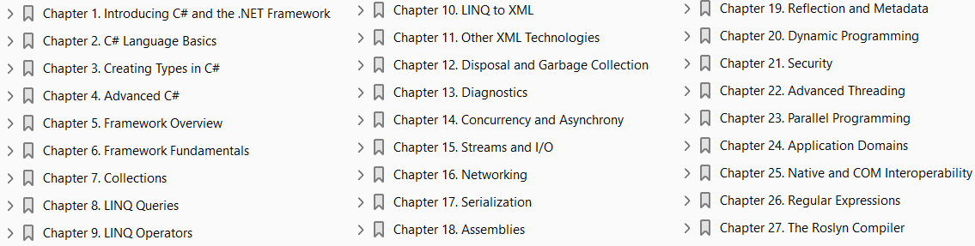

Slide 4
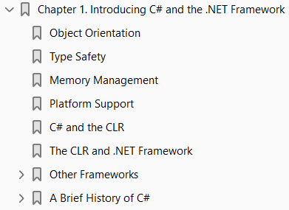
1
Introducing C# and the .NET Framework

Slide 5
Intro
C# is a general-purpose, type-safe, object-oriented programming language.
The goal of the language is programmer productivity.
To this end, C# balances simplicity, expressiveness, and performance.
The chief architect of the language since its first version is Anders Hejlsberg (creator of Turbo Pascal and architect of Delphi).
The C# language is platform-neutral and works with a range of platform-specific compilers and frameworks, most notably the Microsoft .NET Framework for Windows.

Slide 6
Object Orientation
C# is a rich implementation of the object-orientation paradigm, which includes
Encapsulation
Inheritance
Polymorphism
Encapsulation means creating a boundary around an object, to separate its external (public) behavior from its internal (private) implementation details.

Slide 7
Distinctive features of C#
The distinctive features of C# from an object-oriented perspective are:
Unified type system The fundamental building block in C# is an encapsulated unit of data and functions called a type. C# has a unified type system, where all types ultimately share a common base type.
Classes and interfaces In a traditional object-oriented paradigm, the only kind of type is a class.
In C#, there are several other kinds of types, one of which is an interface.
An interface is like a class, except that it only describes members. The implementation for those members comes from types that implement the interface.
Interfaces are particularly useful in scenarios where multiple inheritance is required
Properties, methods, and events In the pure object-oriented paradigm, all functions are methods (this is the case in Smalltalk).
In C#, methods are only one kind of function member, which also includes properties and events (there are others, too).
Properties are function members that encapsulate a piece of an object’s state, such as a button’s color or a label’s text. Events are function members that simplify acting on object state changes.

Slide 8
Functional Programming Paradigm
While C# is primarily an object-oriented language, it also borrows from the functional programming paradigm. Specifically:
Functions can be treated as values Through the use of delegates, C# allows functions to be passed as values to and from other functions.
C# supports patterns for purity Core to functional programming is avoiding the use of variables whose values change, in favor of declarative patterns.
C# has key features to help with those patterns, including the ability to write unnamed functions on the fly that “capture” variables (lambda expressions), and the ability to perform list or reactive programming via query expressions.
C# also makes it easy to define read-only fields and properties for writing immutable (read-only) types.

Slide 9
Type Safety
C# is primarily a type-safe language, meaning that instances of types can interact only through protocols they define, thereby ensuring each type’s internal consistency.
For instance, C# prevents you from interacting with a string type as though it were an integer type.
More specifically, C# supports static typing, meaning that the language enforces type safety at compile time.
This is in addition to type safety being enforced at run-time.
Static typing allows tools such as IntelliSense in Visual Studio to help you write a program, since it knows for a given variable what type it is, and hence what methods you can call on that variable.
Strong typing also plays a role in enabling C# code to run in a sandbox—an environment where every aspect of security is controlled by the host.
C# also allows parts of your code to be dynamically typed via the dynamic keyword. However, C# remains a predominantly statically typed language.

Slide 10
Memory Management
C# relies on the runtime to perform automatic memory management.
The Common Language Runtime(CLR) has a garbage collector that executes as part of your program, reclaiming memory for objects that are no longer referenced.
This frees programmers from explicitly deallocating the memory for an object, eliminating the problem of incorrect pointers encountered in languages such as C++.
C# does not eliminate pointers: it merely makes them unnecessary for most programming tasks.
For performance-critical hotspots and interoperability, pointers and explicit memory allocation is permitted in blocks that are marked unsafe.

Slide 11
Platform Support
Historically, C# was used almost entirely for writing code to run on Windows plat‐ forms.
Recently, however, Microsoft and other companies have invested in other platforms, including
Linux
macOS
iOS, and
Android
Xamarin™ allows cross-platform C# development for mobile applications, and Portable Class Libraries are becoming increasingly widespread.
Microsoft’s ASP.NET Core is a cross-platform lightweight web hosting framework that can run either on the .NET Framework or on .NET Core, an open source cross-platform runtime.

Slide 12
C# and the CLR
C# depends on a runtime equipped with a host of features such as automatic memory management and exception handling.
At the core of the Microsoft .NET Framework is the Common Language Runtime (CLR), which provides these runtime features. (The .NET Core and Xamarin frameworks provide similar runtimes.)
The CLR is language-neutral, allowing developers to build applications in multiple languages (e.g., C#, F#, Visual Basic .NET, and Managed C++).
C# is one of several managed languages that get compiled into managed code. Managed code is represented in Intermediate Language or IL.
The CLR converts the IL into the native code of the machine, such as X86 or X64, usually just prior to execution. This is referred to as Just-In-Time (JIT) compilation.
Ahead-of-time compilation is also available to improve startup time with large assemblies or resource constrained devices (and to satisfy iOS app store rules when developing with Xamarin).
The container for managed code is called an assembly or portable executable. An assembly can be an executable file (.exe) or a library (.dll), and contains not only IL, but type information (metadata).
The presence of metadata allows assemblies to reference types in other assemblies without needing additional files.

Slide 13
IL Assembly
You can examine and disassemble the contents of an IL assembly with Microsoft’s ildasm tool.
And with tools such as ILSpy, dotPeek (JetBrains), or Reflector (Red Gate), you can go further and decompile the IL to C#.
Because IL is higher-level than native machine code, the decompiler can do quite a good job of reconstructing the original C#.
A program can query its own metadata (reflection), and even generate new IL at runtime (reflection.emit).

Slide 14
The CLR and .NET Framework
The .NET Framework consists of the CLR plus a vast set of libraries.
The libraries consist of core libraries and applied libraries, which depend on the core libraries.
Figure 1-1 is a visual overview of those libraries.
The core libraries are sometimes collectively called the Base Class Library (BCL).
The entire framework is called the Framework Class Library (FCL).

Slide 15
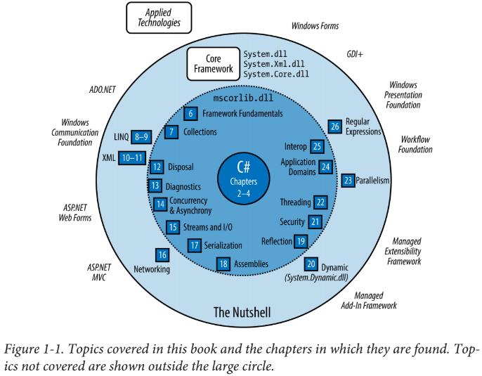
Figure 1-1

Slide 16
Other Frameworks
The Microsoft .NET Framework is the most expansive and mature framework, but runs only on Microsoft Windows (desktop/server).
Over the years, other frameworks have emerged to support other platforms.
There are currently three major players besides the .NET Framework, all of which are currently owned by Microsoft:
Universal Windows Platform (UWP) For writing Windows 10 Store Apps and for targeting Windows 10 devices (mobile, XBox, Surface Hub, Hololens).
Your app runs in a sandbox to lessen the threat of malware, prohibiting operations such as reading or writing arbitrary files.
.NET Core with ASP.NET Core An open source framework (originally based on a cut-down version of the .NET Framework) for writing easily deployable Internet apps and micro-services that run on Windows, macOS, and Linux.
Unlike the .NET Framework, .NET Core can be packaged with the web application and xcopy-deployed (self-contained deployment).

Slide 17
Other Frameworks |
Xamarin For writing mobile apps that target iOS, Android, and Windows Mobile. The Xamarin company was purchased by Microsoft in 2016.

Slide 18
Platform Support for .NET Frameworks
Table 1-1 compares the current platform support for each of the major frameworks.
The four major frameworks differ in
the platforms they support
the libraries that sit on top, and
their intended uses.
However, it’s fair to say that as of the release of .NET Core 2.0, they all expose a similar core framework BCL.
It is even possible to directly leverage this commonality by writing class libraries that work across all four frameworks using .NET Standard 2.0.

Slide 19
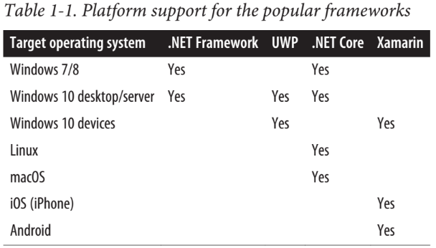
Table 1-1

Slide 20
Legacy and Niche Frameworks
The following frameworks are still available to support older platforms:
Windows Runtime for Windows 8/8.1 (now UWP)
Windows Phone 7/8 (now UWP)
Microsoft XNA for game development (now UWP)
Silverlight (no longer actively developed since the rise of HTML5 and JavaScript)
.NET Core 1.x (the predecessor to .NET Core 2.0, with significantly reduced functionality)
There are also a couple of niche frameworks worth mentioning:
The .NET Micro Framework is for running .NET code on highly resource-constrained embedded devices (under 1 MB).
Mono, the open source framework upon which Xamarin sits, also has libraries to develop cross-platform desktop applications on Linux, macOS, and Windows. Not all features are supported, or work fully.

Slide 21
Windows Runtime
C# also interoperates with Windows Runtime (WinRT) technology.
WinRT means two things: • A language-neutral object-oriented execution interface supported in Windows 8 and above • A set of libraries baked into Windows 8 and above that support the preceding interface
Page: 6

Slide 22
A Brief History of C#
The following is a reverse chronology of the new features in each C# version, for the benefit of readers already familiar with an older version of the language.
What’s New in C# 7.0
What’s New in C# 6.0
What’s New in C# 5.0
What’s New in C# 4.0
What’s New in C# 3.0
What’s New in C# 2.0

Slide 23
What’s New in C# 7.0
C# 7.0 ships with Visual Studio 2017 and has the following improvements:
Numeric literal improvements
Out variables and discards
Patterns
Local methods
More expression-bodied members
Deconstructors
Tuples
throw expressions
Other improvements

Slide 24

Numeric literal improvements
Numeric literals in C# 7 can include underscores to improve readability.
These are called digit separators and are ignored by the compiler:
Binary literals can be specified with the 0b prefix:

Slide 25
Out variables and discards
C# 7 makes it easier to call methods that contain out parameters.
First, you can now declare out variables on the fly:
And when calling a method with multiple out parameters, you can discard ones you’re uninterested in with the underscore character:

Slide 26
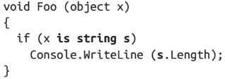
Patterns
You can also introduce variables on the fly with the is operator.
These are called pattern variables.
The switch statement also supports patterns, so you can switch on type as well as constants.
You can specify conditions with a when clause, and also switch on the null value : Listing 1-1

Slide 27
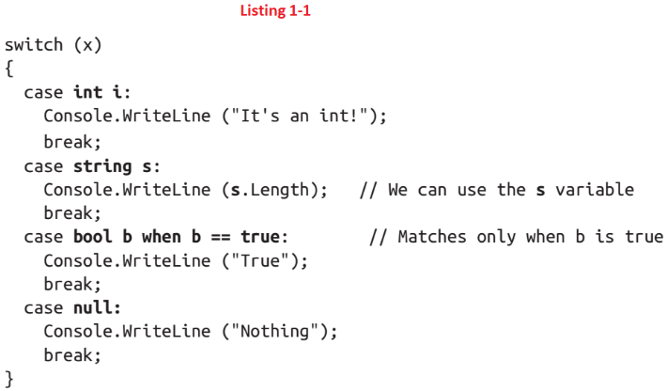
Listing 1-1

Slide 28
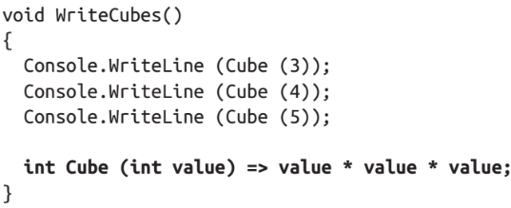
Local Methods
A local method is a method declared inside another function
Local methods are visible only to the containing function, and can capture local variables in the same way that lambda expressions do.

Slide 29
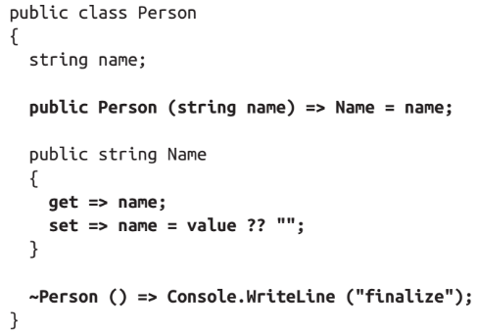
More expression-bodied members
C# 6 introduced the expression-bodied “fat-arrow” syntax for
Methods
read-only properties
Operators
Indexers
C# 7 extends this to
Constructors
read/write properties
Finalizers

Slide 30
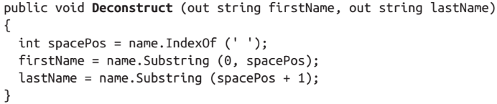
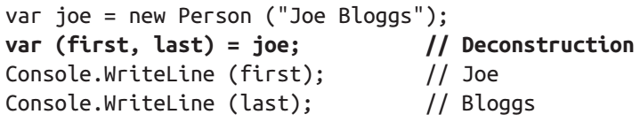
Deconstructors
C# 7 introduces the deconstructor pattern.
Whereas a constructor typically takes a set of values (as parameters) and assigns them to fields, a deconstructor does the reverse and assigns fields back to a set of variables.
We could write a deconstructor for the Person class in the preceding example as follows (exception-handling aside):
Deconstructors are called with the following special syntax:

Slide 31
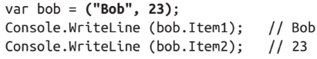
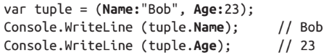
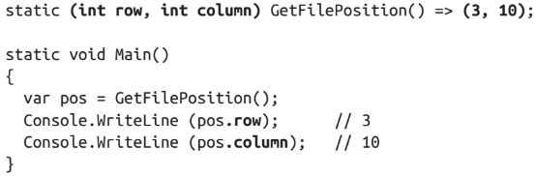
Tuples
The most notable improvement to C# 7 is explicit tuple support.
Tuples provide a simple way to store a set of related values:
C#’s new tuples are syntactic sugar for using the System.ValueTuple<...> generic structs.
But thanks to compiler magic, tuple elements can be named:
With tuples, functions can return multiple values without resorting to out parameters:

Slide 32
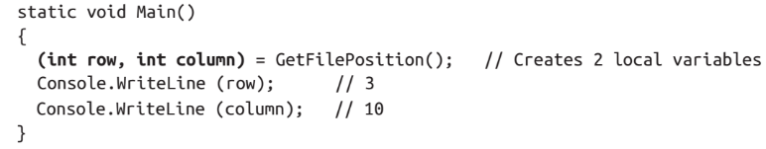
Tuples |
Tuples implicitly support the deconstruction pattern, so they can easily be deconstructed into individual variables.
We can rewrite the preceding Main method so that the tuple returned by GetFilePosition is instead assigned to two local variables, row and column:

Slide 33
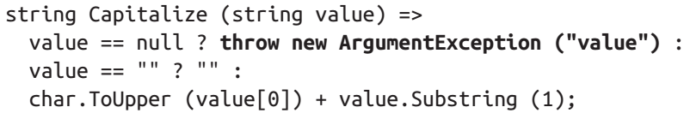
throw Expressions
Prior to C# 7, throw was always a statement.
Now it can also appear as an expression in expression-bodied functions:
A throw expression can also appear in a ternary conditional expression:

Slide 34
Other Improvements
C# 7 also includes a couple of features for
Specialized micro-optimization scenarios
Ref Locals
Ref Returns
The ability to declare asynchronous methods with return types other than Task / Task<T>

Slide 35
What’s New in C# 6.0
C# 6.0, which shipped with Visual Studio 2015, features a new-generation compiler, completely written in C#.
Known as project “Roslyn,” the new compiler exposes the entire compilation pipeline via libraries, allowing you to perform code analysis on arbitrary source code (see Chapter 27).
The compiler itself is open source, and the source code is available at github.com/dotnet/roslyn.
C# 6.0 features a number of minor, but significant enhancements, aimed primarily at reducing code clutter.
The null-conditional (“Elvis”) operator Expression-bodied functions
Property initializers Index initializers
String interpolation Exception filters
The using static directive The nameof (Chapter 3) operator
And finally, you’re now allowed to await inside catch and finally blocks.

Slide 36
The null-conditional (“Elvis”) operator
The null-conditional (“Elvis”) operator avoids having to explicitly check for null before calling a method or accessing a type member.
In the following example, result evaluates to null instead of throwing a NullReferenceException:

Slide 37
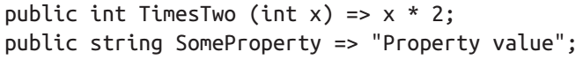
Expression-bodied functions
Expression-bodied functions allow methods, properties, operators, and indexers that comprise a single expression to be written more tersely, in the style of a lambda expression:

Slide 38
Property initializers
Property initializers let you assign an initial value to an automatic property:
Initialized properties can also be read-only:
Read-only properties can also be set in the constructor, making it easier to create immutable (read-only) types.

Slide 39
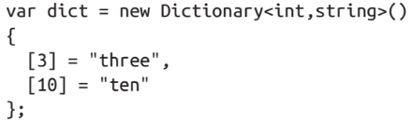
Index initializers
Index initializers allow single-step initialization of any type that exposes an indexer:

Slide 40
String interpolation
String interpolation offers a succinct alternative to string.Format:

Slide 41
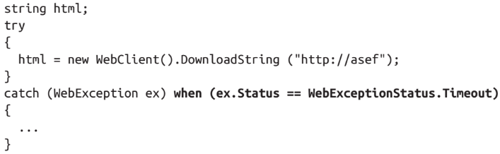
Exception filters
Exception filters let you apply a condition to a catch block:

Slide 42
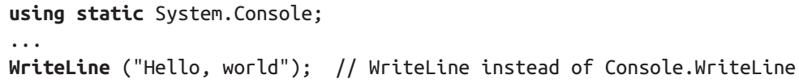
The using static directive
The using static directive lets you import all the static members of a type, so that you can use those members unqualified:

Slide 43
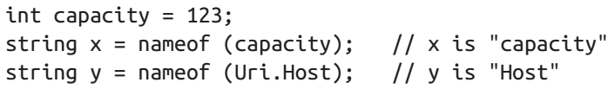
The nameof operator
The nameof operator returns the name of
Variable
Type
Other symbol
as a string
This avoids breaking code when you rename a symbol in Visual Studio:

Slide 44
What’s New in C# 5.0
C# 5.0’s big new feature was support for asynchronous functions via two new keywords
async
await
Asynchronous functions enable asynchronous continuations, which make it easier to write responsive and thread-safe rich-client applications.
They also make it easy to write highly concurrent and efficient I/O bound applications that don’t tie up a thread resource per operation.
We cover asynchronous functions in detail in Chapter 14.

Slide 45
What’s New in C# 4.0
The features new to C# 4.0 were:
Dynamic binding
Optional parameters and named arguments
Type variance with generic interfaces and delegates
COM interoperability improvements

Slide 46
Dynamic binding
Dynamic binding defers binding—the process of resolving types and members—from compile time to runtime and is useful in scenarios that would otherwise require complicated reflection code.
Dynamic binding is also useful when interoperating with
dynamic languages
COM components

Slide 47
Optional parameters and named arguments
Optional parameters allow functions to specify default parameter values so that callers can omit arguments and named arguments allow a function caller to identify an argument by name rather than position.

Slide 48
Type variance with generic interfaces and delegates
Type variance rules were relaxed in C# 4.0, such that type parameters in generic interfaces and generic delegates can be marked as covariant or contravariant, allowing more natural type conversions.

Slide 49
COM interoperability improvements
COM interoperability was enhanced in C# 4.0 in three ways.
First, arguments can be passed by reference without the ref keyword (particularly useful in conjunction with optional parameters).
Second, assemblies that contain COM interop types can be linked rather than referenced.
Linked interop types support type equivalence, avoiding the need for Primary Interop Assemblies and putting an end to versioning and deployment headaches.
Third, functions that return COM-Variant types from linked interop types are mapped to dynamic rather than object, eliminating the need for casting.

Slide 50
What’s New in C# 3.0
The features added to C# 3.0 were mostly centered on Language Integrated Query capabilities (LINQ).
LINQ enables queries to be written directly within a C# program and checked statically for correctness, and query both local collections (such as lists or XML documents) or remote data sources (such as a database).
The C# 3.0 features added to support LINQ comprised
implicitly typed local variables anonymous types
object initializers lambda expressions
extension methods query expressions
expression trees
C# 3.0 also added
automatic properties
partial methods

Slide 51
Implicitly typed local variables
Implicitly typed local variables (var keyword) let you omit the variable type in a declaration statement, allowing the compiler to infer it.
This reduces clutter as well as allowing anonymous types.
Arrays can also be implicitly typed.

Slide 52
Anonymous types
Anonymous types are simple classes created on the fly that are commonly used in the final output of LINQ queries.

Slide 53
Object initializers
Object initializers simplify object construction by allowing properties to be set inline after the constructor call.
Object initializers work with both named and anonymous types.

Slide 54
Lambda expressions
Lambda expressions are miniature functions created by the compiler on the fly, and are particularly useful in “fluent” LINQ queries

Slide 55
Extension methods
Extension methods extend an existing type with new methods (without altering the type’s definition), making static methods feel like instance methods.
LINQ’s query operators are implemented as extension methods.

Slide 56
Query expressions
Query expressions provide a higher-level syntax for writing LINQ queries that can be substantially simpler when working with multiple sequences or range variables.

Slide 57
Expression Trees
Expression trees are miniature code DOMs (Document Object Models) that describe lambda expressions assigned to the special type Expression<TDelegate>.
Expression trees make it possible for LINQ queries to execute remotely (e.g., on a database server) because they can be introspected and translated at runtime (e.g., into a SQL statement).

Slide 58
Automatic Properties
Automatic properties cut the work in writing properties that simply get/set a private backing field by having the compiler do that work automatically.

Slide 59
Partial Methods
Partial methods let an auto-generated partial class provide customizable hooks for manual authoring that “melt away” if unused.

Slide 60
What’s New in C# 2.0
The big new features in C# 2 were
generics (Chapter 3),
nullable types (Chapter 4),
iterators (Chapter 4)
anonymous methods (the predecessor to lambda expressions)
These features paved the way for the introduction of LINQ in C# 3.
C# 2 also added support for
partial classes
static classes
a host of minor and miscellaneous features such as the
namespace alias qualifier friend assemblies fixed-size buffers
The introduction of generics required a new CLR (CLR 2.0), because generics maintain full type fidelity at runtime.

Slide 61
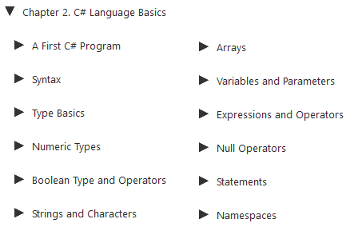
2
C# Language Basics

Slide 62
Intro
In this chapter, we introduce the basics of the C# language.
All programs and code snippets in this and the following two chapters are available as interactive samples in LINQPad.
Working through these samples in conjunction with the book accelerates learning in that you can edit the samples and instantly see the results without needing to set up projects and solutions in Visual Studio.
To download the samples, click the Samples tab in LINQPad, and then click “Download more samples.” LINQPad is free— go to http://www.linqpad.net.

Slide 64
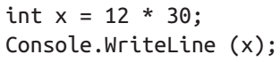
A first C# Program
The Listing 2-1 shows a program that multiplies 12 by 30 and prints the result, 360, to the screen.
The double forward slash indicates that the remainder of a line is a comment.
At the heart of this program lie two statements:
Statements in C# execute sequentially and are terminated by a semicolon (or a code block, as we’ll see later).
The first statement computes the expression 12 * 30 and stores the result in a local variable, named x, which is an integer type.
The second statement calls the Console class’s WriteLine method, to print the variable x to a text window on the screen.
A method performs an action in a series of statements, called a statement block—a pair of braces containing zero or more statements. We defined a single method named Main.

Slide 65
A first C# Program |
Writing higher-level functions that call upon lower-level functions simplifies a program.
We can refactor our program with a reusable method that multiplies an integer by 12 as shown in Listing 2-2.

Slide 66
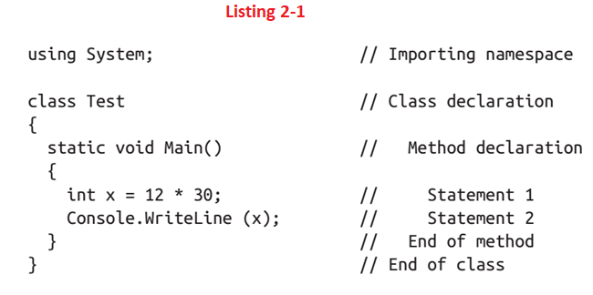
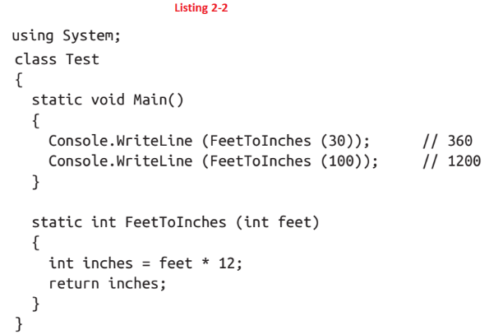
Listing 2-1 || 2-2

Slide 67
Methods
A method can receive input data from the caller by specifying parameters and output data back to the caller by specifying a return type.
We defined a method called FeetToInches that has a parameter for inputting feet, and a return type for outputting inches:
The literals 30 and 100 are the arguments passed to the FeetToInches method.

Slide 68

Main Method
The Main method in our example has empty parentheses because it has no parameters, and is void because it doesn’t return any value to its caller:
C# recognizes a method called Main as signaling the default entry point of execution.
The Main method may optionally return an integer (rather than void) in order to return a value to the execution environment (where a nonzero value typically indicates an error).
The Main method can also optionally accept an array of strings as a parameter (that will be populated with any arguments passed to the executable).
For example:

Slide 69
Functions
Methods are one of several kinds of functions in C#.
Another kind of function we used in our example program was the * operator, which performs multiplication.
There are also constructors, properties, events, indexers, and finalizers.
In our example, the two methods are grouped into a class.

Slide 70

Class
A class groups function members and data members to form an object-oriented building block.
The Console class groups members that handle command-line input/output functionality, such as the WriteLine method.
Our Test class groups two methods—the Main method and the FeetToInches method. At the outermost level of a program, types are organized into namespaces.
The using directive was used to make the System namespace available to our application, to use the Console class. We could define all our classes within the TestPrograms namespace, as shown in Listing 2-3.
The .NET Framework is organized into nested namespaces.
For example, this is the namespace that contains types for handling text:
The using directive is there for convenience; you can also refer to a type by its fully qualified name, which is the type name prefixed with its namespace, such as System.Text.StringBuilder.

Slide 71
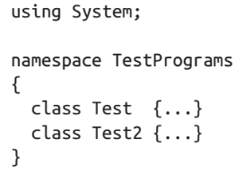
Listing 2-3

Slide 72
Compilation
The C# compiler compiles source code, specified as a set of files with the .cs extension, into an assembly.
An assembly is the unit of packaging and deployment in .NET.
An assembly can be either an application or a library.
A normal console or Windows application has a Main method and is an .exe file.
A library is a .dll and is equivalent to an .exe without an entry point. Its purpose is to be called upon (referenced) by an application or by other libraries.
The .NET Framework is a set of libraries.
The name of the C# compiler is csc.exe. You can either use an IDE such as Visual Studio to compile, or call csc manually from the command line.
Peculiarly, .NET Framework 4.6 and 4.7 still ship with the C# 5 compiler.
To obtain the C# 7 command-line compiler, you must install Visual Studio 2017 or MSBuild 15.

Slide 73
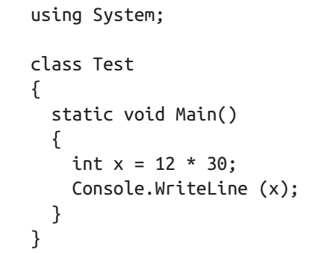
Syntax
C# syntax is inspired by C and C++ syntax.
Consider the below program to understand the C#’s elements of syntax:

Slide 74
Identifiers and Keywords
Identifiers are names that programmers choose for their classes, methods, variables, and so on.
These are the identifiers in our example program, in the order they appear:
An identifier must be a whole word, essentially made up of Unicode characters starting with a letter or underscore.
C# identifiers are case-sensitive.
By convention, parameters, local variables, and private fields should be in camel case (e.g., myVariable), and
all other identifiers should be in Pascal case (e.g., MyMethod).
Keywords are names that mean something special to the compiler. These are the keywords in our example program:
Most keywords are reserved, which means that you can’t use them as identifiers.
Listing 2-4 shows the full list of C# reserved keywords:

Slide 75
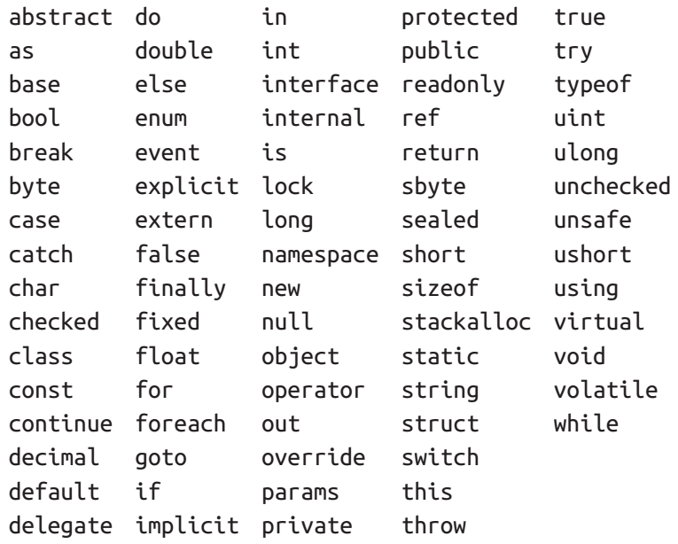
Listing 2-4

Slide 76
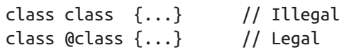
Avoiding Conflict
If you really want to use an identifier that clashes with a reserved keyword, you can do so by qualifying it with the @ prefix.
For instance:
The @ symbol doesn’t form part of the identifier itself.
So @myVariable is the same as myVariable.
The @ prefix can be useful when consuming libraries written in other .NET languages that have different keywords.

Slide 77
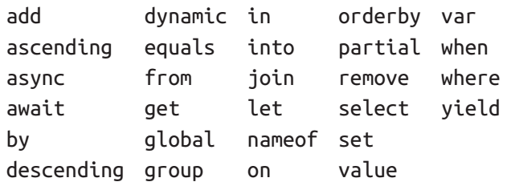
Contextual Keywords
Some keywords are contextual, meaning they can also be used as identifiers— without an @ symbol.
These are:
With contextual keywords, ambiguity cannot arise within the context in which they are used.

Slide 78

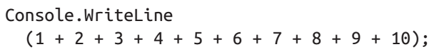
Literals, Punctuators, and Operators
Literals are primitive pieces of data lexically embedded into the program.
The literals we used in our example program are 12 and 30.
Punctuators help demarcate the structure of the program.
These are the punctuators we used in our example program:
The braces group multiple statements into a statement block.
The semicolon terminates a statement. (Statement blocks, however, do not require a semicolon.)
Statements can wrap multiple lines:

Slide 79

Operators
An operator transforms and combines expressions.
Most operators in C# are denoted with a symbol, such as the multiplication operator, *.
We will discuss operators in more detail later in this chapter. These are the operators we used in our example program:
A period denotes a member of something (or a decimal point with numeric literals).
Parentheses are used when declaring or calling a method; empty parentheses are used when the method accepts no arguments. (Parentheses also have other purposes that we’ll see later in this chapter.)
An equals sign performs assignment.

Slide 80
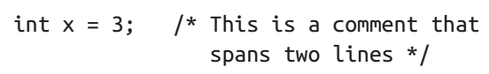
Comments
C# offers two different styles of source-code documentation:
single-line comments and
multiline comments
A single-line comment begins with a double forward slash and continues until the end of the line. For example:
A multiline comment begins with /* and ends with */. For example:
Comments may embed XML documentation tags, explained in “XML Documentation” in Chapter 4.

Slide 81
Type Basics

Slide 82
Numeric types

Slide 83
Boolean type and Operators

Slide 84
Strings and characters

Slide 85
Arrays

Slide 86
Variables and Parameters

Slide 87
Expressions and Operators

Slide 88
Null Operators

Slide 89
Statements

Slide 90
Namespaces

Slide 91
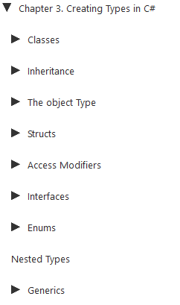
3
Creating Types in C#

Slide 92
Intro
In this chapter, we will delve into types and type members.

Slide 93
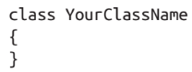
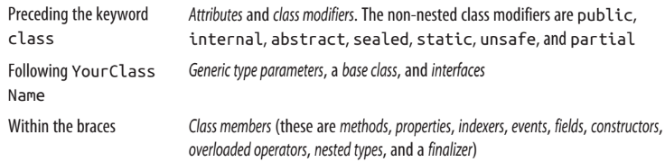
Classes
A class is the most common kind of reference type.
The simplest possible class declaration is as follows:
A more complex class optionally has the following:
This chapter covers all of these constructs except
Attributes
operator functions, and

Slide 94
Classes |
the unsafe keyword
which are covered in Chapter 4.
The following sections enumerate each of the class members.

Slide 95
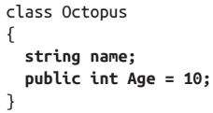
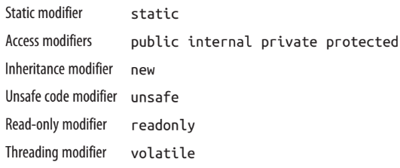
Fields
A field is a variable that is a member of
a class or
struct
Ex:
Fields allow the following modifiers:

Slide 96
The readonly modifier
The readonly modifier prevents a field from being modified after construction.
A read-only field can be assigned
only in its declaration or
within the enclosing type’s constructor

Slide 97

Field initialization
Field initialization is optional.
An uninitialized field has a default value
0
\0
null
false
Field initializers run before constructors:

Slide 98
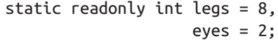
Declaring multiple fields together
For convenience, you may declare multiple fields of the same type in a comma separated list.
This is a convenient way for all the fields to share the
same attributes and
field modifiers
For example:

Slide 99
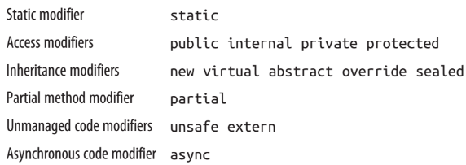
Methods
A method performs an action in a series of statements.
A method can receive input data from the caller by specifying parameters and output data back to the caller by specifying a return type.
A method can specify a void return type, indicating that it doesn’t return any value to its caller. It can also output data back to the caller via ref/out parameters.
A method’s signature must be unique within the type.
A method’s signature comprises its name and parameter types in order (but not the parameter names, nor the return type).
Methods allow the following modifiers:

Slide 100

Expression-bodied Methods
A method that comprises a single expression, such as the following:
can be written more tersely as an expression-bodied method.
A fat arrow replaces the braces and return keyword:
Expression-bodied functions can also have a void return type:

Slide 101
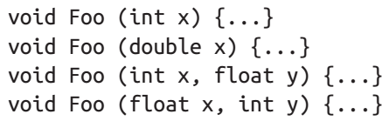
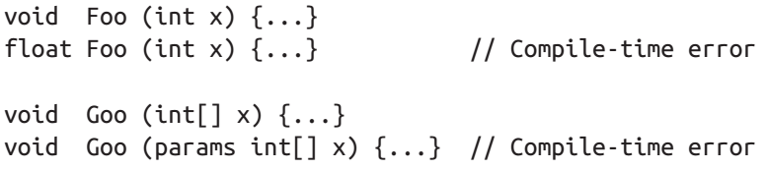
Overloading Methods
A type may overload methods (have multiple methods with the same name), as long as the signatures are different.
For example, the following methods can all coexist in the same type:
However, the following pairs of methods cannot coexist in the same type, since the return type and the params modifier are not part of a method’s signature:

Slide 102
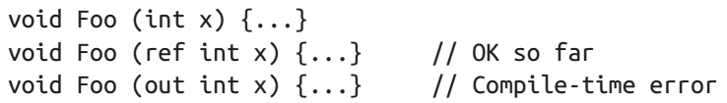
Pass-by-value vs Pass-by-Reference
Whether a parameter is pass-by-value or pass-by-reference is also part of the signature.
For example, Foo(int) can coexist with either Foo(ref int) or Foo(out int).
However, Foo(ref int) and Foo(out int) cannot coexist:

Slide 103
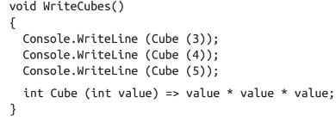
Local Methods
From C# 7, you can define a method inside another method:
The local method (Cube, in this case) is visible only to the enclosing method (Write Cubes). This simplifies the containing type and instantly signals to anyone looking at the code that Cube is used nowhere else.
Another benefit of local methods is that they can access the local variables and parameters of the enclosing method.
Local methods can appear inside other function kinds, such as
property accessors
constructors, and so on
You can even put local methods inside other local methods, and inside lambda expressions that use a statement block.

Slide 104
Local Methods |
Local methods can be
iterators or
asynchronous
The static modifier is invalid for local methods.
They are implicitly static if the enclosing method is static.

Slide 105
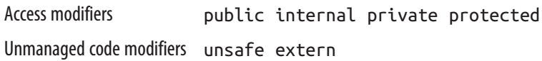
Instance Constructors
Constructors run initialization code on a class or struct.
A constructor is defined like a method, except that the method name and return type are reduced to the name of the enclosing type: Listing 3-1.
Instance constructors allow the following modifiers:
From C# 7, single-statement constructors can also be written as expression-bodied members:

Slide 106
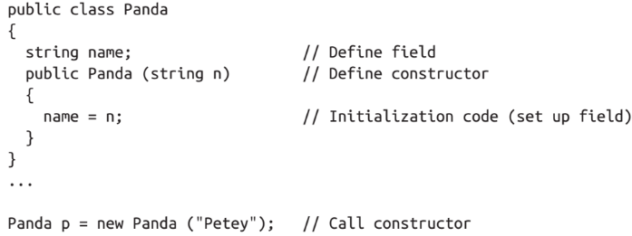
Listing 3-1

Slide 107
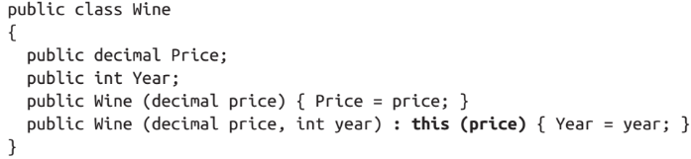
Overloading constructors
A class or struct may overload constructors.
To avoid code duplication, one constructor may call another, using the this keyword:
When one constructor calls another, the called constructor executes first.
You can pass an expression into another constructor as follows:
The expression itself cannot make use of the this reference, for example, to call an instance method. (This is enforced because the object has not been initialized by the constructor at this stage, so any methods that you call on it are likely to fail.)
It can, however, call static methods.

Slide 108
Implicit parameterless constructors
For classes, the C# compiler automatically generates a parameterless public constructor if and only if you do not define any constructors.
However, as soon as you define at least one constructor, the parameterless constructor is no longer automatically generated.

Slide 109
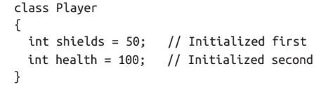
Constructor and field initialization order
We saw previously that fields can be initialized with default values in their declaration:
Field initializations occur before the constructor is executed, and in the declaration order of the fields.

Slide 110
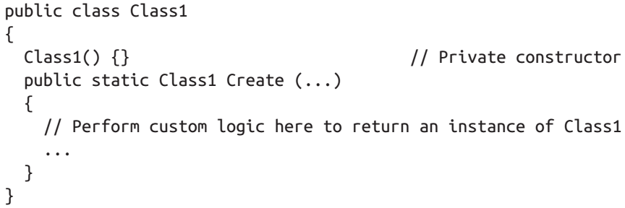
Nonpublic constructors
Constructors do not need to be public.
A common reason to have a nonpublic constructor is to control instance creation via
a static method call.
The static method could be used to return
an object from a pool
rather than necessarily creating a new object, or
return various subclasses based on input arguments:

Slide 111
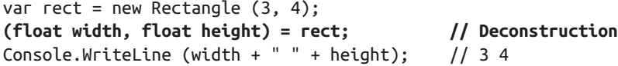
Deconstructors (C# 7)
C# 7 introduces the deconstructor pattern.
A deconstructor (also called a deconstructing method) acts as an approximate opposite to a constructor:
Whereas a constructor typically takes a set of values (as parameters) and assigns them to fields
a deconstructor does the reverse and assigns fields back to a set of variables
A deconstruction method must be called Deconstruct, and have one or more out parameters, such as in the following class: Listing 3-2.
To call the deconstructor, we use the following special syntax:
The second line is the deconstructing call.
It creates two local variables and then calls the Deconstruct method. Our deconstructing call is equivalent to:
(Page 85).

Slide 112
Listing 3-2

Slide 113
Object Initializers
To simplify object initialization, any accessible fields or properties of an object can be set via an object initializer directly after construction.
For example, consider the following class:
(Page 85).

Slide 114
The this Reference

Slide 115
Properties

Slide 116
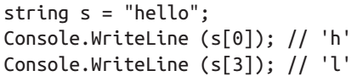
Indexers
Indexers provide a natural syntax for accessing elements in a class or struct that encapsulate
a list or
dictionary of values
Indexers are similar to properties, but are accessed via an index argument rather than a property name.
The string class has an indexer that lets you access each of its char values via an int index:
The syntax for using indexers is like that for using arrays, except that the index argument(s) can be of any type(s).
Indexers have the same modifiers as properties (see “Properties” on page 87), and can be called null-conditionally by inserting a question mark before the square bracket (see “Null Operators” on page 60 in Chapter 2):

Slide 117
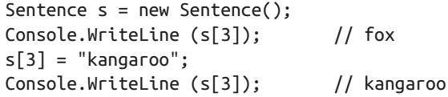

Implementing an indexer
To write an indexer, define a property called this, specifying the arguments in square brackets.
For instance: Listing 3A-1.
Here’s how we could use this indexer:
A type may declare multiple indexers, each with parameters of different types.
An indexer can also take more than one parameter:
If you omit the set accessor, an indexer becomes read-only, and expression-bodied syntax may be used in C# 6 to shorten its definition:

Slide 118

Listing 3A-1

Slide 119
CLR indexer implementation
Indexers internally compile to methods called get_Item and set_Item, as follows:

Slide 120
Constants

Slide 121
Static Constructors

Slide 122
Static Classes

Slide 123
Finalizers

Slide 124
Partial Types and Methods

Slide 125
The nameof Operator (C# 6)

Slide 126
Inheritance
A class can inherit from another class to extend or customize the original class.
Inheriting from a class lets you reuse the functionality in that class instead of building it from scratch.
A class can inherit from only a single class, but can itself be inherited by many classes, thus forming a class hierarchy.
In this example, we start by defining a class called Asset:
(Page 96).

Slide 127
Polymorphism
References are polymorphic. This means a variable of type x can refer to an object that subclasses x. For instance, consider the following method:
(Page 97).

Slide 128
Casting and Reference Conversions
An object reference can be: • Implicitly upcast to a base class reference • Explicitly downcast to a subclass reference Upcasting and downcasting between compatible reference types performs reference conversions: a new reference is (logically) created that points to the same object. An upcast always succeeds; a downcast succeeds only if the object is suitably typed.
(Page 97).

Slide 129
Upcasting
An upcast operation creates a base class reference from a subclass reference. For example:
(Page 97).

Slide 130
Downcasting
A downcast operation creates a subclass reference from a base class reference. For example:
(Page 98).

Slide 131
The as operator
The as operator performs a downcast that evaluates to null (rather than throwing an exception) if the downcast fails:
(Page 98).

Slide 132
The is operator
The is operator tests whether a reference conversion would succeed; in other words, whether an object derives from a specified class (or implements an inter‐ face). It is often used to test before downcasting.
(Page 99).

Slide 133
The is operator and pattern variables (C# 7)
From C# 7, you can introduce a variable while using the is operator:
(Page 99).

Slide 134
Virtual Function Members
A function marked as virtual can be overridden by subclasses wanting to provide a specialized implementation. Methods, properties, indexers, and events can all be declared virtual:
(Page 100).

Slide 135
Abstract Classes and Abstract Members
A class declared as abstract can never be instantiated. Instead, only its concrete sub‐ classes can be instantiated. Abstract classes are able to define abstract members. Abstract members are like vir‐ tual members, except they don’t provide a default implementation. That implemen‐ tation must be provided by the subclass, unless that subclass is also declared abstract:
(Page 101).

Slide 136
Hiding Inherited Members
A base class and a subclass may define identical members. For example:
(Page 101).

Slide 137
new versus override
Consider the following class hierarchy:
(Page 102).

Slide 138
Sealing Functions and Classes
An overridden function member may seal its implementation with the sealed key‐ word to prevent it from being overridden by further subclasses. In our earlier vir‐ tual function member example, we could have sealed House’s implementation of Liability, preventing a class that derives from House from overriding Liability, as follows:
(Page 102).

Slide 139

The base Keyword
The base keyword is similar to the this keyword.
It serves two essential purposes:
Accessing an overridden function member from the subclass
Calling a base-class constructor (see the next section)
In this example, House uses the base keyword to access Asset’s implementation of Liability:
With the base keyword, we access Asset’s Liability property nonvirtually.
This means we will always access Asset’s version of this property—regardless of the instance’s actual runtime type.
The same approach works if Liability is hidden rather than overridden. (You can also access hidden members by casting to the base class before invoking the function.)

Slide 140
Constructors and Inheritance
A subclass must declare its own constructors. The base class’s constructors are accessible to the derived class, but are never automatically inherited. For example, if we define Baseclass and Subclass as follows:
(Page 103).

Slide 141
Implicit calling parameterless base-class constructor
If a constructor in a subclass omits the base keyword, the base type’s parameterless constructor is implicitly called:
(Page 104).

Slide 142
Constructor and field initialization order
When an object is instantiated, initialization takes place in the following order:
From subclass to base class:
Fields are initialized
Arguments to base-class constructor calls are evaluated
From base class to subclass:
Constructor bodies execute
The following code demonstrates:
(Page 104).

Slide 143
Overloading and Resolution
Inheritance has an interesting impact on method overloading. Consider the follow‐ ing two overloads:
(Page 105).

Slide 144
The Object Type

Slide 145
Structs

Slide 146
Access Modifiers

Slide 147

Interfaces
An interface is similar to a class, but it provides a specification rather than an implementation for its members.
An interface is special in the following ways:
Interface members are all implicitly abstract.
In contrast, a class can provide both abstract members and concrete members with implementations.
A class (or struct) can implement multiple interfaces.
In contrast, a class can inherit from only a single class, and
a struct cannot inherit at all (aside from deriving from System.ValueType)
Here is the definition of the IEnumerator interface, defined in System.Collections:
Interface members are always implicitly public and cannot declare an access modifier.

Slide 148


Implementation
Implementing an interface means providing a public implementation for all its members:
You can implicitly cast an object to any interface that it implements.
For example:

Slide 149

NOTE
Even though Countdown is an internal class, its members that implement IEnumerator can be called publicly by casting an instance of Countdown to IEnumerator.
For instance, if a public type in the same assembly defined a method as follows:
If IEnumerator was itself defined as internal, this wouldn’t be possible.

Slide 150
Extending an Interface
Interfaces may derive from other interfaces.
For instance:
IRedoable “inherits” all the members of IUndoable.
In other words, types that implement IRedoable must also implement the members of IUndoable.

Slide 151

Explicit Interface Implementation
Implementing multiple interfaces can sometimes result in a collision between member signatures.
You can resolve such collisions by explicitly implementing an interface member.
Consider the following example: Listing E-1.
Because both I1 and I2 have conflicting Foo signatures, Widget explicitly implements I2’s Foo method.
This lets the two methods coexist in one class.
The only way to call an explicitly implemented member is to cast to its interface:
Another reason to explicitly implement interface members is to hide members that are highly specialized and distracting to a type’s normal use case.
For example, a type that implements ISerializable would typically want to avoid flaunting its ISerializable members unless explicitly cast to that interface.

Slide 152

Listing E-1

Slide 153

Implementing Interface Members Virtually
An implicitly implemented interface member is, by default, sealed.
It must be marked
virtual or
Abstract
in the base class in order to be overridden
For example: Listing E-2.
Calling the interface member through either the base class or the interface calls the subclass’s implementation:
An explicitly implemented interface member
cannot be marked virtual
nor can it be overridden in the usual manner
It can, however, be reimplemented.

Slide 154

Listing E-2

Slide 155
Reimplementing an Interface in a Subclass
A subclass can reimplement any interface member already implemented by a base class. Reimplementation hijacks a member implementation (when called through the interface) and works whether or not the member is virtual in the base class. It also works whether a member is implemented implicitly or explicitly—although it works best in the latter case, as we will demonstrate. In the following example, TextBox implements IUndoable.Undo explicitly, and so it cannot be marked as virtual. In order to “override” it, RichTextBox must reimplement IUndoable’s Undo method:
(Page 115).

Slide 156
Interfaces and Boxing
Converting a struct to an interface causes boxing.
Calling an implicitly implemented member on a struct does not cause boxing:
(Page 117).

Slide 157
Enums

Slide 158
Nested Types

Slide 159
Generics
C# has two separate mechanisms for writing code that is reusable across different types:
Inheritance
Generics
Whereas inheritance expresses reusability with a base type
generics express reusability with a “template” that contains “placeholder” types.
Generics, when compared to inheritance, can
increase type safety and
reduce casting and boxing
C# generics and C++ templates are similar concepts, but they work differently.

Slide 160

Generic Types
A generic type declares type parameters
placeholder types to be filled in by the consumer of the generic type, which supplies the type arguments
Here is a generic type Stack<T>, designed to stack instances of type T.
Stack<T> declares a single type parameter T:
Stack<int> fills in the type parameter T with the type argument int, implicitly creating a type on the fly (the synthesis occurs at runtime).
Technically, we say that Stack<T> is an open type, whereas Stack<int> is a closed type.

Slide 161

Generic Types |
At runtime, all generic type instances are closed—with the placeholder types filled in.
This means that the following statement is illegal:
unless inside a class or method that itself defines T as a type parameter:

Slide 162


Why Generics Exist
Generics exist to write code that is reusable across different types.
Suppose we needed a stack of integers, but we didn’t have generic types.
One solution would be to hardcode a separate version of the class for every required element type (e.g., IntStack, StringStack, etc.).
Clearly, this would cause considerable code duplication.
Another solution would be to write a stack that is generalized by using object as the element type:
An ObjectStack would require boxing and downcasting that could not be checked at compile time:

Slide 163
Why Generics Exist |
What we need is both
a general implementation of a stack that works for all element types, and
a way to easily specialize that stack to a specific element type for
increased type safety and
reduced casting and boxing
Generics give us precisely this, by allowing us to parameterize the element type.
Stack<T> has the benefits of both
ObjectStack and
IntStack
Like ObjectStack, Stack<T> is written once to work generally across all types.
Like IntStack, Stack<T> is specialized for a particular type - the beauty is that this type is T, which we substitute on the fly.
ObjectStack is functionally equivalent to Stack<object>.

Slide 164


Generic Methods
A generic method declares type parameters within the signature of a method.
With generic methods, many fundamental algorithms can be implemented in a general-purpose way only.
Here is a generic method that swaps the contents of two variables of any type T:
Swap<T> can be used as follows:
Generally, there is no need to supply type arguments to a generic method, because the compiler can implicitly infer the type.

Slide 165

Generic Methods |
If there is ambiguity, generic methods can be called with the type arguments as follows:
Within a generic type, a method is not classed as generic unless it introduces type parameters (with the angle bracket syntax).
The Pop method in our generic stack merely uses the type’s existing type parameter, T, and is not classed as a generic method.
Methods and types are the only constructs that can introduce type parameters.
Properties
Indexers
Events
Fields
Constructors
operators, and so on
cannot declare type parameters, although they can partake in any type parameters already declared by their enclosing type.

Slide 166
Generic Methods ||
In our generic stack example, for instance, we could write an indexer that returns a generic item:
Similarly, constructors can partake in existing type parameters, but not introduce them:

Slide 167

Declaring Type parameters
Type parameters can be introduced in the declaration of
Classes
Structs
Interfaces
delegates (covered in Chapter 4), and
Methods
Other constructs, such as properties, cannot introduce a type parameter, but can use one.
For example, the property Value uses T:
A generic type or method can have multiple parameters.
For example:

Slide 168

Declaring Type parameters |
To instantiate:
Or:
Generic type names and method names can be overloaded as long as the number of type parameters is different.
For example, the following three type names do not conflict:

Slide 169
NOTE
By convention, generic types and methods with a single type parameter typically name their parameter T, as long as the intent of the parameter is clear.
When using multiple type parameters, each parameter is prefixed with T, but has a more descriptive name.

Slide 170

typeof and Unbound Generic Types
Open generic types do not exist at runtime:
open generic types are closed as part of compilation.
However, it is possible for an unbound generic type to exist at runtime —purely as a Type object.
The only way to specify an unbound generic type in C# is with the typeof operator:
Open generic types are used in conjunction with the Reflection API (Chapter 19).
You can also use the typeof operator to specify a closed type:
or an open type (which is closed at runtime):

Slide 171

The default Generic Value
The default keyword can be used to get the default value for a generic type parameter.
The default value for a reference type is null, and
the default value for a value type is the result of bitwise-zeroing the value type’s fields:

Slide 172


Generic Constraints
By default, a type parameter can be substituted with any type whatsoever.
Constraints can be applied to a type parameter to require more specific type arguments.
These are the possible constraints:
In the following example, GenericClass<T,U> requires
T to derive from (or be identical to) SomeClass and
implement Interface1, and
requires U to provide a parameterless constructor:

Slide 173
Generic Constraints |
Constraints can be applied wherever type parameters are defined, in both
methods and
type definitions

Slide 174


Constraints
A base-class constraint specifies that the type parameter must subclass (or match) a particular class;
an interface constraint specifies that the type parameter must implement that interface
These constraints allow instances of the type parameter to be implicitly converted to that
class or
interface
For example, suppose we want to write a generic Max method, which returns the maximum of two values.
We can take advantage of the generic interface defined in the framework called IComparable<T>:
CompareTo returns a positive number if this is greater than other.
Using this interface as a constraint, we can write a Max method as follows (to avoid distraction, null checking is omitted):

Slide 175

Constraints |
The Max method can accept arguments of any type implementing IComparable<T> (which includes most built-in types such as int and string):
The class constraint and struct constraint specify that T must be
a reference type or
(non-nullable) value type
A great example of the struct constraint is the System.Nullable<T> struct (we will discuss this class in depth in “Nullable Types” on page 173 in Chapter 4):
The parameterless constructor constraint requires T to have a public parameterless constructor.
If this constraint is defined, you can call new( ) on T:

Slide 176


Constraints ||
The naked type constraint requires one type parameter to derive from (or match) another type parameter.
In this example, the method FilteredStack returns another Stack, containing only the subset of elements where the type parameter U is of the type parameter T:

Slide 177


Subclassing Generic Types
A generic class can be subclassed just like a nongeneric class.
The subclass can leave the base class’s type parameters open, as in the following example:
Or the subclass can close the generic type parameters with a concrete type:
A subtype can also introduce fresh type arguments:

Slide 178
NOTE
Technically, all type arguments on a subtype are fresh:
you could say that a subtype closes and
then reopens the base type arguments
This means that a subclass can give new (and potentially more meaningful) names to the type arguments it reopens:

Slide 179

Self-Referencing Generic Declarations
A type can name itself as the concrete type when closing a type argument:
The following are also legal:

Slide 180

Static Data
Static data is unique for each closed type:

Slide 181

Type Parameters and Conversions
C#’s cast operator can perform several kinds of conversion, including:
Numeric conversion
Reference conversion
Boxing/unboxing conversion
Custom conversion (via operator overloading; see Chapter 4)
The decision as to which kind of conversion will take place happens at compile time, based on the known types of the operands.
This creates an interesting scenario with generic type parameters, because the precise operand types are unknown at compile time.
If this leads to ambiguity, the compiler generates an error.
The most common scenario is when you want to perform a reference conversion:

Slide 182

Type Parameters and Conversions |
Without knowledge of T’s actual type, the compiler is concerned that you might have intended this to be a custom conversion.
The simplest solution is to instead use the as operator, which is unambiguous because it cannot perform custom conversions:
A more general solution is to first cast to object.
This works because conversions to/from object are assumed not to be custom conversions, but
reference or
boxing/ unboxing conversions
In this case, StringBuilder is a reference type, so it has to be a reference conversion:

Slide 183
Type Parameters and Conversions ||
Unboxing conversions can also introduce ambiguities.
The following could be
an unboxing,
numeric, or
custom conversion:
The solution, again, is to first cast to object and then to int (which then unambiguously signals an unboxing conversion in this case):

Slide 184

Covariance
Assuming A is convertible to B, X has a covariant type parameter if X<A> is convertible to X<B>.
For instance, type IFoo<T> has a covariant T if the following is legal:
From C# 4.0, interfaces permit covariant type parameters (as do delegates—see Chapter 4)
but classes do not.
Arrays also allow covariance (A[ ] can be converted to B[ ] if A has an implicit reference conversion to B), and are discussed here for comparison.

Slide 185
NOTE
With C#’s notion of covariance (and contravariance), “convertible” means convertible via an implicit reference conversion —such as
A subclassing B, or
A implementing B
Numeric conversions
boxing conversions, and
custom conversions
are not included.

Slide 186
NOTE
Covariance and contravariance (or simply “variance”) are advanced concepts.
The motivation behind introducing and enhancing variance in C# was to allow
generic interface and
generic types (in particular, those defined in the Framework, such as IEnumerable<T>)
to work more as you’d expect
You can benefit from this without understanding the details behind
covariance and
contravariance

Slide 187

Variance is not automatic
To ensure static type safety, type parameters are not automatically variant.
Consider the code: Listing 3V-1.
The following fails to compile:
That restriction prevents the possibility of runtime failure with the following code:
Lack of covariance, however, can hinder reusability.
Suppose, for instance, we wanted to write a method to Wash a stack of animals:

Slide 188


Variance is not automatic |
Calling Wash with a stack of bears would generate a compile-time error.
One work‐ around is to redefine the Wash method with a constraint:
We can now call Wash as follows:
Another solution is to have Stack<T> implement an interface with a covariant type parameter, as we’ll see shortly.

Slide 189

Listing 3V-1

Slide 190

Arrays
For historical reasons, array types support covariance.
This means that B[ ] can be cast to A[ ] if B subclasses A (and both are reference types).
For example:
The downside of this reusability is that element assignments can fail at runtime:

Slide 191

Declaring a covariant type parameter
As of C# 4.0, type parameters on interfaces and delegates can be declared covariant by marking them with the out modifier.
This modifier ensures that, unlike with arrays, covariant type parameters are fully type-safe.
We can illustrate this with our Stack<T> class by having it implement the following interface:
The out modifier on T indicates that T is used only in output positions (e.g., return types for methods).
The out modifier flags the type parameter as covariant and allows us to do this:
The conversion from bears to animals is permitted by the compiler
by virtue of the type parameter being covariant

Slide 192

Declaring a covariant type parameter |
This is type-safe because the case the compiler is trying to avoid—pushing a Camel onto the stack—can’t occur as there’s no way to feed a Camel into an interface where T can appear only in output positions.
We can leverage the ability to cast covariantly to solve the reusability problem described earlier:
The compiler will generate an error if you use a covariant type parameter in an input position (e.g., a parameter to a method or a writable property).

Slide 193
NOTE
Covariance (and contravariance) in interfaces is something that you typically consume:
it’s less common that you need to write variant interfaces
Curiously, method parameters marked as out are not eligible for covariance, due to a limitation in the CLR.
The IEnumerator<T> and IEnumerable<T> interfaces described in Chapter 7 have a covariant T.
This allows you to cast IEnumerable<string> to IEnumerable<object>, for instance.
Covariance (and contravariance) works only for elements with reference conversions
not boxing conversions
This applies both to
type parameter variance and
array variance
So, if you wrote a method that accepted a parameter of type IPoppable<object>, you could call it with IPoppable<string>, but not IPoppable<int>.

Slide 194

Contravariance
We previously saw that, assuming that A allows an implicit reference conversion to B, a type X has a covariant type parameter if X<A> allows a reference conversion to X<B>.
Contravariance is when you can convert in the reverse direction—from X<B> to X<A>.
This is supported if the type parameter appears only in input positions, and is designated with the in modifier.
Extending our previous example, if the Stack<T> class implements the following interface:
we can legally do this:
No member in IPushable outputs a T, so we can’t get into trouble by casting animals to bears (there’s no way to Pop, for instance, through that interface).

Slide 195
NOTE
Our Stack<T> class can implement both IPushable<T> and IPoppable<T>—despite T having opposing variance annotations in the two interfaces!
This works because you must exercise variance through the interface and not the class; therefore, you must commit to the lens of either IPoppable or IPushable before performing a variant conversion.
This lens then restricts you to the operations that are legal under the appropriate variance rules.
This also illustrates why classes do not allow variant type parameters:
concrete implementations typically require data to flow in both directions.

Slide 197

4
Advanced C#

Slide 198
Intro
In this chapter, we cover advanced C# topics that build on concepts explored in Chapters 2 and 3.
You should read the first four sections sequentially; you can read the remaining sections in any order.

Slide 199

Delegates
A delegate is an object that knows how to call a method.
A delegate type defines the kind of method that delegate instances can call.
Specifically, it defines
the method’s return type and
its parameter types
The following defines a delegate type called Transformer:
Transformer is compatible with any method with an int return type and a single int parameter, such as this:
Assigning a method to a delegate variable creates a delegate instance:
which can be invoked in the same way as a method:

Slide 200


Example
Here’s a complete example: Listing 4-0.
A delegate instance literally acts as a delegate for the caller:
the caller invokes the delegate, and
then the delegate calls the target method
This indirection decouples the caller from the target method.
The statement:
The expression:

Slide 201

Listing 4-0

Slide 202
NOTE
A delegate is similar to a callback, a general term that captures constructs such as C function pointers.

Slide 203
Writing Plug-in Methods with Delegates
A delegate variable is assigned a method at runtime.
This is useful for writing plugin methods.
In this example: Listing 4-1, we have a utility method named Transform that applies a transform to each element in an integer array.
The Transform method has a delegate parameter, for specifying a plug-in transform.
Our Transform method is a higher-order function, because it’s a function that takes a function as an argument. (A method that returns a delegate would also be a higher-order function.)

Slide 204

Listing 4-1

Slide 206
Multicast Delegates
All delegate instances have multicast capability.
This means that a delegate instance can reference not just a single target method, but also a list of target methods.
The + and += operators combine delegate instances.
For example:
(Page 139).

Slide 207
Instance Versus Static Method Targets
When an instance method is assigned to a delegate object, the latter must maintain a reference not only to the method, but also to the instance to which the method belongs. The System.Delegate class’s Target property represents this instance (and will be null for a delegate referencing a static method). For example:
(Page 141).
(Page 140).

Slide 208
Generic Delegate Types
A delegate type may contain generic type parameters.
For example:
With this definition, we can write a generalized Transform utility method that works on any type:
(Page 141).

Slide 209
The Func and Action Delegates
With generic delegates, it becomes possible to write a small set of delegate types that are so general they can work for methods of any return type and any (reasonable) number of arguments.
These delegates are the
Func and
Action delegates
defined in the System namespace (the in and out annotations indicate variance, which we will cover shortly):
These delegates are extremely general.
The Transformer delegate in our previous example can be replaced with a Func delegate that takes a single argument of type T and returns a same-typed value:
(Page 142).

Slide 210
Delegates Versus Interfaces
A problem that can be solved with a delegate can also be solved with an interface. For instance, we can rewrite our original example with an interface called ITransformer instead of a delegate:
(Page 142).

Slide 211
Delegate Compatibility
We will explore the following sub-topics:
Type compatibility
Parameter compatibility
(Page 144).

Slide 212
Type compatibility
Delegate types are all incompatible with one another, even if their signatures are the same:
(Page 144).

Slide 213
Parameter compatibility
When you call a method, you can supply arguments that have more specific types than the parameters of that method. This is ordinary polymorphic behavior. For exactly the same reason, a delegate can have more specific parameter types than its method target. This is called contravariance. Here’s an example:
(Page 144).

Slide 214
Return type compatibility
If you call a method, you may get back a type that is more specific than what you asked for. This is ordinary polymorphic behavior. For exactly the same reason, a delegate’s target method may return a more specific type than described by the dele‐ gate. This is called covariance. For example:
(Page 145).

Slide 215
Generic delegate type parameter variance
In Chapter 3 we saw how generic interfaces support covariant and contravariant type parameters. The same capability exists for delegates too (from C# 4.0 onward). If you’re defining a generic delegate type, it’s good practice to: • Mark a type parameter used only on the return value as covariant (out). • Mark any type parameters used only on parameters as contravariant (in). Doing so allows conversions to work naturally by respecting inheritance relation‐ ships between types. The following delegate (defined in the System namespace) has a covariant TResult:
(Page 145).

Slide 216
Events
When using delegates, two emergent roles commonly appear:
broadcaster and
Subscriber
The broadcaster is a type that contains a delegate field.
The broadcaster decides when to broadcast, by invoking the delegate.
The subscribers are the method target recipients.
A subscriber decides when to start and stop listening, by calling
+= and
-= on the broadcaster’s delegate
A subscriber does not know about, or interfere with, other subscribers.
Events are a language feature that formalizes this pattern.
An event is a construct that exposes just the subset of delegate features required for the broadcaster/ subscriber model.
The main purpose of events is to prevent subscribers from interfering with one another.
The easiest way to declare an event is to put the event keyword in front of a delegate member:

Slide 217
Standard Event Pattern
The .NET Framework defines a standard pattern for writing events. Its purpose is to provide consistency across both Framework and user code. At the core of the stan‐ dard event pattern is System.EventArgs: a predefined Framework class with no members (other than the static Empty property). EventArgs is a base class for con‐ veying information for an event. In our Stock example, we would subclass Even tArgs to convey the old and new prices when a PriceChanged event is fired:
(Page 148).

Slide 218
Event Accessors
An event’s accessors are the implementations of its += and -= functions. By default, accessors are implemented implicitly by the compiler. Consider this event declara‐ tion: public event EventHandler PriceChanged; The compiler converts this to the following: • A private delegate field • A public pair of event accessor functions (add_PriceChanged and remove_Pri ceChanged), whose implementations forward the += and -= operations to the private delegate field You can take over this process by defining explicit event accessors. Here’s a manual implementation of the PriceChanged event from our previous example:
(Page 152).

Slide 219
Event Modifiers Like methods, events can be
Virtual
Overridden
Abstract or
Sealed
Events can also be static:

Slide 220
Lambda Expressions
A lambda expression is an unnamed method written in place of a delegate instance.
The compiler immediately converts the lambda expression to either:
A delegate instance
An expression tree, of type Expression<TDelegate>, representing the code inside the lambda expression in a traversable object model
This allows the lambda expression to be interpreted later at runtime (see “Building Query Expressions” on page 400 in Chapter 8).
Given the following delegate type:
(Page 153).

Slide 221
Explicitly Specifying => Parameter Types
The compiler can usually infer the type of lambda parameters contextually. When this is not the case, you must specify the type of each parameter explicitly. Consider the following two methods:
(Page 154).

Slide 222
Capturing Outer Variables
A lambda expression can reference the local variables and parameters of the method in which it’s defined (outer variables). For example:
(Page 155).

Slide 223
Lambda Expressions Versus Local Methods
The functionality of C# 7’s local methods (see “Local methods” on page 9 in Chap‐ ter 1) overlaps with that of lambda expressions. Local methods have the following three advantages: • They can be recursive (they can call themselves), without ugly hacks • They avoid the clutter of specifying a delegate type • They incur slightly less overhead Local methods are more efficient because they avoid the indirection of a delegate (which costs some CPU cycles and a memory allocation). They can also access local variables of the containing method without the compiler having to “hoist” the cap‐ tured variables into a hidden class. However, in many cases you need a delegate, most commonly when calling a higher-order function, i.e., a method with a delegate-typed parameter:
(Page 157).

Slide 224
Anonymous Methods
Anonymous methods are a C# 2.0 feature that has been mostly subsumed by C# 3.0’s lambda expressions.
An anonymous method is like a lambda expression, but it lacks the following features:
Implicitly typed parameters
Expression syntax (an anonymous method must always be a statement block)
The ability to compile to an expression tree, by assigning to Expression<T> To write an anonymous method, you include the delegate keyword followed (optionally) by a parameter declaration and then a method body.
For example, given this delegate:
(Page 158).

Slide 225
try Statements and Exceptions
A try statement specifies a code block subject to error-handling or cleanup code.
The try block must be followed by a
catch block,
a finally block, or
both
The catch block executes when an error occurs in the try block.
The finally block executes after execution leaves the try block (or if present, the catch block), to perform cleanup code, whether or not an error occurred. A catch block has access to an Exception object that contains information about the error. You use a catch block to either compensate for the error or rethrow the exception. You rethrow an exception if you merely want to log the problem, or if you want to rethrow a new, higher-level exception type. A finally block adds determinism to your program: the CLR endeavors to always execute it. It’s useful for cleanup tasks such as closing network connections. A try statement looks like this:

Slide 226
The catch Clause
A catch clause specifies what type of exception to catch.
This must either be
System.Exception or
a subclass of System.Exception
Catching System.Exception catches all possible errors.
This is useful when:
Your program can potentially recover regardless of the specific exception type
You plan to rethrow the exception (perhaps after logging it)
Your error handler is the last resort, prior to termination of the program
More typically, though, you catch specific exception types, in order to avoid having to deal with circumstances for which your handler wasn’t designed (e.g., an OutOfMemoryException).
(Page 160).

Slide 227
Exception filters (C# 6)
From C# 6.0, you can specify an exception filter in a catch clause by adding a when clause:
If a WebException is thrown in this example, the Boolean expression following the when keyword is then evaluated. If the result is false, the catch block in question is ignored, and any subsequent catch clauses are considered. With exception filters, it can be meaningful to catch the same exception type again:
(Page 162).

Slide 228
The finally Block
A finally block always executes—whether or not an exception is thrown and whether or not the try block runs to completion. finally blocks are typically used for cleanup code. A finally block executes either: • After a catch block finishes • After control leaves the try block because of a jump statement (e.g., return or goto) • After the try block ends The only things that can defeat a finally block are an infinite loop, or the process ending abruptly. A finally block helps add determinism to a program. In the following example, the file that we open always gets closed, regardless of whether: • The try block finishes normally. • Execution returns early because the file is empty (EndOfStream). • An IOException is thrown while reading the file.
(Page 162).

Slide 229
The using statement
Many classes encapsulate unmanaged resources, such as
file handles
graphics handles, or
database connections
These classes implement System.IDisposable, which defines a single parameterless method named Dispose to clean up these resources.
The using statement provides an elegant syntax for calling Dispose on an IDisposable object within a finally block.
The following:
(Page 163).

Slide 230
Throwing Exceptions
Exceptions can be thrown either by
the runtime or
in user code
In this example, Display throws a System.ArgumentNullException:
(Page 163).

Slide 231
throw expressions (C# 7)
Prior to C# 7, throw was always a statement.
Now it can also appear as an expression in expression-bodied functions:
(Page 164).

Slide 232
Rethrowing an exception
You can capture and rethrow an exception as follows:
(Page 164).

Slide 233
Key Properties of System.Exception
The most important properties of System.Exception are the following:
StackTrace A string representing all the methods that are called from the origin of the exception to the catch block.
Message A string with a description of the error.
InnerException The inner exception (if any) that caused the outer exception. This, itself, may have another InnerException.
(Page 165).

Slide 234
NOTE
All exceptions in C# are runtime exceptions—there is no equivalent to Java’s compile-time checked exceptions.

Slide 235
Common Exception Types
The following exception types are used widely throughout the CLR and .NET Framework. You can throw these yourself or use them as base classes for deriving custom exception types.
(Page 165).

Slide 236
The TryXXX Method Pattern
When writing a method, you have a choice, when something goes wrong, to return some kind of failure code or throw an exception. In general, you throw an exception when the error is outside the normal workflow—or if you expect that the immediate caller won’t be able to cope with it. Occasionally, though, it can be best to offer both choices to the consumer. An example of this is the int type, which defines two ver‐ sions of its Parse method:
(Page 166).

Slide 237
Alternatives to Exceptions
As with int.TryParse, a function can communicate failure by sending an error code back to the calling function via a return type or parameter. Although this can work with simple and predictable failures, it becomes clumsy when extended to all errors, polluting method signatures and creating unnecessary complexity and clut‐ ter. It also cannot generalize to functions that are not methods, such as operators (e.g., the division operator) or properties. An alternative is to place the error in a common place where all functions in the call stack can see it (e.g., a static method that stores the current error per thread). This, though, requires each function to participate in an error-propagation pattern that is cumbersome and, ironically, itself error-prone.
(Page 167).

Slide 238
Enumeration and Iterators

Slide 239
Nullable Types

Slide 240
Extension Methods

Slide 241
Anonymous Types

Slide 242
Tuples (C# 7)

Slide 243
Attributes
You’re already familiar with the notion of attributing code elements of a program with modifiers, such as
virtual or
Ref
These constructs are built into the language.
Attributes are an extensible mechanism for adding custom information to code elements
Assemblies Types
Members Return values
Parameters, and Generic type parameters
This extensibility is useful for services that integrate deeply into the type system, without requiring special keywords or constructs in the C# language.
A good scenario for attributes is serialization—the process of converting arbitrary objects to and from a particular format.
In this scenario, an attribute on a field can specify the translation between C#’s representation of the field and the format’s representation of the field.

Slide 244


Attribute Classes
An attribute is defined by a class that inherits (directly or indirectly) from the abstract class System.Attribute.
To attach an attribute to a code element, specify the attribute’s type name in square brackets, before the code element.
For example, the following attaches the ObsoleteAttribute to the Foo class:
This attribute is recognized by the compiler and will cause compiler warnings if a type or member marked obsolete is referenced.
By convention, all attribute types end in the word Attribute.
C# recognizes this and allows you to omit the suffix when attaching an attribute:

Slide 245
Attribute Classes |
ObsoleteAttribute is a type declared in the System namespace as follows (simplified for brevity):
The C# language and the .NET Framework include a number of predefined attributes.
We describe how to write your own attributes in Chapter 19.

Slide 246
Named and Positional Attribute Parameters
Attributes may have parameters.
In the following example, we apply XmlElementAttribute to a class.
This attribute tells XML serializer (in System.Xml.Serialization) how an object is represented in XML and accepts several attribute parameters.
The following attribute maps the CustomerEntity class to an XML element named Customer, belonging to the http://oreilly.com namespace:
Attribute parameters fall into one of two categories:
Positional or
Named
In the preceding example, the first argument is a positional parameter;
the second is a named parameter

Slide 247
Named and Positional Attribute Parameters |
Positional parameters correspond to
parameters of the attribute type’s public constructors
Named parameters correspond to
public fields or
public properties on the attribute type
When specifying an attribute, you must include positional parameters that correspond to one of the attribute’s constructors.
Named parameters are optional.
In Chapter 19, we describe
the valid parameter types and
rules for their evaluation

Slide 248

Attribute Targets
Implicitly, the target of an attribute is the code element it immediately precedes, which is typically
a type or
type member
You can also attach attributes, however, to an assembly.
This requires that you explicitly specify the attribute’s target.
Here is an example of using the CLSCompliant attribute to specify CLS compliance for an entire assembly:

Slide 249

Specifying Multiple Attributes
Multiple attributes can be specified for a single code element.
Each attribute can be listed either
within the same pair of square brackets (separated by a comma) or
in separate pairs of square brackets (or a combination of the two)
The following three examples are semantically identical:

Slide 250
Caller Info Attributes
From C# 5, you can tag optional parameters with one of three caller info attributes, which instruct the compiler to feed information obtained from the caller’s source code into the parameter’s default value:
[CallerMemberName] applies the caller’s member name
[CallerFilePath] applies the path to caller’s source code file
[CallerLineNumber] applies the line number in caller’s source code file
The Foo method in the following program demonstrates all three:

Slide 251
Dynamic Binding

Slide 252
Operator Overloading

Slide 253
Unsafe Code and Pointers

Slide 254
Preprocessor Directives

Slide 255
XML Documentation

Slide 256

5
Framework Overview

Slide 257
Intro
Almost all the capabilities of the .NET Framework are exposed via a vast set of managed types.
These types are organized into hierarchical namespaces and packaged into a set of assemblies, which together with the CLR (Common Language Runtime) comprise the .NET platform.
Some of the .NET types are used directly by the CLR and are essential for the managed hosting environment.
These types reside in an assembly called mscorlib.dll and include C#’s built-in types, as well as the basic collection classes, types for stream processing, serialization, reflection, threading, and native interoperability.
mscorlib” is an abbreviation for “Multi-language Standard Common Object Runtime Library”.
At a level above this are additional types that “flesh out” the CLR-level functionality, providing features such as XML Networking LINQ
These reside in System.dll, System.Xml.dll, and System.Core.dll, and together with mscorlib, they provide a rich programming environment upon which the rest of the Framework is built.
The remainder of the .NET Framework consists of applied APIs, most of which cover three areas of functionality: User-interface technologies Backend technologies Distributed system technologies
Table 5-1 shows the history of compatibility between each version of C#, the CLR, and the .NET Framework.

Slide 258

Table 5-1

Slide 259
What’s New in .NET Framework 4.6
The Garbage Collector (GC) offers more control over when (not) to collect via new methods on the GC class. There are also more fine-tuning options when calling GC.Collect.
There’s a brand-new faster 64-bit JIT compiler.
The System.Numerics namespace now includes hardware-accelerated matrix, vector types, BigInteger and Complex.
There’s a new System.AppContext class, designed to give library authors a consistent mechanism for letting consumers switch new API features in or out.
Tasks now pick up the current thread’s culture and UI culture when created.
More collection types now implement IReadOnlyCollection<T>.
WPF has further improvements, including better touch and high-DPI handling.
ASP.NET now supports HTTP/2 and the Token Binding Protocol in Windows 10.

Slide 260
Tip
Assemblies and namespaces in the .NET Framework cross-cut.
The most extreme examples are mscorlib.dll and System.Core.dll, both defining types in dozens of namespaces, none of which is prefixed with mscorlib or System.Core.
The less obvious cases are the more confusing ones, however, such as the types in System.Security.Cryptography.
Most types in this namespace reside in System.dll, except for a handful, which reside in System.Security.dll.

Slide 261
Core Types
Many of the core types are defined in the following assemblies:
mscorlib.dll
System.dll
System.Core.dll
The first of these, mscorlib.dll, comprises the types required by the runtime environment itself; System.dll and System.Core.dll contain additional core types required by you as a programmer.
The reason the latter two are separate is historical: when Microsoft introduced Framework 3.5, they made it additive insofar as it ran as a layer over the existing CLR 2.0.
Therefore, almost all new core types (such as the classes supporting LINQ) went into a new assembly that Microsoft called System.Core.dll.

Slide 262
What’s New in .NET Framework 4.7
Framework 4.7 is more of a maintenance release than a new-feature release, with numerous bug fixes and minor improvements. Additionally:
The System.ValueTuple struct is part of Framework 4.7, so you can use tuples in C# 7 without referencing the System.ValueTuple.dll assembly.
WPF has better touch support.
Windows Forms has better support for high-DPI monitors.

Slide 263
.NET Standard 2.0
There are three main alternatives to the .NET Framework for cross-platform development:
UWP for Windows 10 devices/desktop
.NET Core/ASP.NET Core for Windows, Linux, and MacOS
Xamarin for mobile devices (iOS, Android, and Windows 10 devices)
As of .NET Core 2.0, these frameworks—along with .NET Framework 4.6.1 and later—have converged in their core functionality, and now all offer a base class library (BCL) with similar types and members.
This commonality has been formalized into a standard called .NET Standard 2.0.
When you write a library in Visual Studio 2017, you can choose to target .NET Standard 2.0 instead of a specific framework.
Your library is then portable, and the same assembly will run without modification on (modern versions of) all four frameworks.
.NET Standard is not a Framework; it’s merely a specification describing a minimum baseline of functionality (types and members), which guarantees compatibility with a certain set of frameworks.
The concept is similar to C# interfaces: .NET Standard is like an interface that concrete types (frameworks) can implement.

Slide 264
Older .NET Standards
There are also older .NET Standards in use, most notably 1.1, 1.2, 1.3, and 1.6.
A higher-numbered standard is always a strict superset of a lower-numbered standard.
For instance, if you write a library that targets .NET Standard 1.6, you will support not only recent versions of the four major frameworks, but also .NET Core 1.0.
And if you target .NET Standard 1.3, you support everything we’ve already mentioned plus .NET Framework 4.6.0 (see Table 5-2).
You can also think of .NET Standard as a lowest common denominator.
In the case of .NET Standard 2.0, the four frameworks that implement it have a similar Base Class Library, so the lowest common denominator is big and useful.
However, if you also want compatibility with .NET Core 1.0 (with its significantly cut-down BCL), the lowest common denominator—.NET Standard 1.x—becomes much smaller and less useful.

Slide 265

Table 5-2

Slide 266
.NET 1.x Standards
The 1.x standards lack thousands of APIs that are present in 2.0.
This can make targeting a 1.x standard significantly more challenging, especially if you need to integrate existing code or libraries.
If you need to support older frameworks but don’t need cross-platform compatibility, a better option is to target an older version of a specific framework.
In the case of Windows, a good choice is .NET Framework 4.5 because it’s widely deployed (pre-installed on all machines running Windows 8 and later), and it contains most of what’s in .NET Framework 4.7.

Slide 267
Reference Assemblies
When compiling a program, you must reference the assemblies that contain the portions of the framework that your program consumes.
For instance, a simple Console program for .NET Framework that includes a LINQ-to-XML query would require
mscorlib.dll System.dll
System.Xml.dll System.Xml.Linq.dll
System.Core.dll
In Visual Studio, this is done by adding references to the project (the ones we just listed are added automatically when creating projects that target .NET Framework 4.x).
The assemblies that you reference, however, only need exist for the benefit of the compiler, and don’t need to be the same ones that are used at runtime.
Hence, it’s permissible to use special reference assemblies that exist as empty shells, without any compiled code.
This is how .NET Standard works: You add a reference assembly called netstandard.dll, which contains all of the allowable types and members in .NET Standard 2.0 (but no actual compiled code).

Slide 268
Reference Assemblies |
Then, through assembly redirection attributes, the “real” assemblies are loaded at runtime. (The choice of “real” assemblies will depend on which framework the assembly eventually runs on.)
Reference assemblies also allow you to target a lower Framework version than is installed on your machine.
For instance, if you’ve installed .NET Framework 4.7 along with Visual Studio 2017, you can still tell your project to target .NET Framework 4.0.
Thanks to a set of Framework 4.0 reference assemblies, your project will only be able to see the types/members of Framework 4.0.

Slide 269
The CLR and Core Framework
This study of this topics involves the following sub-topics:
System Types Text Processing
Collections Queries
XML Diagnostics
Concurrency and Asynchrony Streams and I/O
Networking Serialization
Dynamic Programming Security
Advanced Threading Parallel Programming
Application Domains Native and COM Interoperability

Slide 270
System Types
The most fundamental types live directly in the System namespace.
These include C#’s built-in types, the Exception base class, the Enum, Array, and Delegate base classes, and Nullable, Type, DateTime, TimeSpan, and Guid.
The System namespace also includes types for performing mathematical functions (Math), generating random numbers (Random), and converting between various types (Convert and Bit Converter).
Chapter 6 describes these types—as well as the interfaces that define standard protocols used across the .NET Framework for such tasks as formatting (IFormattable) and order comparison (IComparable).
The System namespace also defines the IDisposable interface and the GC class for interacting with the garbage collector. These topics are saved for Chapter 12.

Slide 271
Text Processing
The System.Text namespace contains the StringBuilder class (the editable or mutable cousin of string), and the types for working with text encodings, such as UTF-8 (Encoding and its subtypes).
We cover this in Chapter 6.
The System.Text.RegularExpressions namespace contains types that perform advanced pattern-based search-and-replace operations; these are described in Chapter 26.

Slide 272

Collections
The .NET Framework offers a variety of classes for managing collections of items.
These include both list- and dictionary-based structures, and work in conjunction with a set of standard interfaces that unify their common characteristics.
All collection types are defined in the following namespaces, covered in Chapter 7:

Slide 273

Queries
Language Integrated Query (LINQ) was added in Framework 3.5.
LINQ allows you to perform type-safe queries over local and remote collections (e.g., SQL Server tables) and is described in Chapters 8 through 10.
A big advantage of LINQ is that it presents a consistent querying API across a variety of domains.
The essential types reside in the following namespaces, and are part of .NET Standard 2.0:
The full .NET Framework also includes the following, which we describe in “Back‐ end Technologies” on page 225:

Slide 274

XML
XML is used widely within the .NET Framework, and so is supported extensively.
Chapter 10 focuses entirely on LINQ to XML—a lightweight XML document object model that can be constructed and queried through LINQ.
Chapter 11 describes the older W3C DOM, as well as the performant low-level reader/writer classes and the Framework’s support for XML schemas, stylesheets, and XPath.
The XML namespaces are:

Slide 275
Diagnostics
In Chapter 13, we cover .NET’s logging and assertion facilities and describe how to interact with other processes, write to the Windows event log, and use performance counters for monitoring.
The types for this are defined in and under System.Diagnostics.
Windows-specific features are not part of .NET Standard, and are available only in the .NET Framework.

Slide 276
Concurrency and Asynchrony
Many modern applications need to deal with more than one thing happening at a time.
Since C# 5.0, this has become easier through asynchronous functions and high-level constructs such as tasks and task combinators.
Chapter 14 explains all of this in detail, after starting with the basics of multithreading.
Types for working with threads and asynchronous operations are in the
System.Threading
System.Threading.Tasks namespaces

Slide 277
Stream and I/O
The Framework provides a stream-based model for low-level input/output.
Streams are typically used to read and write directly to files and network connections, and can be chained or wrapped in decorator streams to add compression or encryption functionality.
Chapter 15 describes .NET’s stream architecture, as well as the specific support for working with files and directories, compression, isolated storage, pipes, and memory-mapped files.
The .NET Stream and I/O types are defined in and under the System.IO namespace, and the WinRT types for file I/O are in and under Windows.Storage.

Slide 278

Networking
You can directly access standard network protocols such as HTTP, FTP, TCP/IP, and SMTP via the types in System.Net.
In Chapter 16, we demonstrate how to communicate using each of these protocols, starting with simple tasks such as downloading from a web page, and finishing with using TCP/IP directly to retrieve POP3 email.
Here are the namespaces we cover:
The latter two namespaces are unavailable to Windows Store applications if you’re targeting Windows 8/8.1 (WinRT), but are available to Windows 10 Store apps (UWP) as part of the .NET Standard 2.0 contract.
For WinRT apps, use third-party libraries for sending mail, and the WinRT types in Windows.Networking.Sockets for working with sockets.

Slide 279

Serialization
The Framework provides several systems for saving and restoring objects to a binary or text representation.
Such systems are required for distributed application technologies, such as WCF, Web Services, and Remoting, and also to save and restore objects to a file.
In Chapter 17, we cover the three major serialization engines:
the data contract serializer
the binary serializer
the XML serializer.
There is also a JSON serializer now available in the .NET Framework
The types for serialization reside in the following namespaces:

Slide 280

Assemblies, Reflection and Attributes
The assemblies into which C# programs compile comprise executable instructions (stored as intermediate language or IL) and metadata, which describes the program’s types, members, and attributes.
Through reflection, you can inspect this metadata at runtime, and do such things as dynamically invoke methods.
With Reflection.Emit, you can construct new code on the fly.
In Chapter 18, we describe the makeup of assemblies and how to sign them, use the global assembly cache (GAC) and resources, and resolve file references.
In Chapter 19, we cover reflection and attributes—describing how to inspect metadata, dynamically invoke functions, write custom attributes, emit new types, and parse raw IL.
The types for using reflection and working with assemblies reside in the following namespaces:

Slide 281
Dynamic Programming
In Chapter 20, we look at some of the patterns for dynamic programming and leveraging the Dynamic Language Runtime, which has been a part of the CLR since Framework 4.0.
We describe how to implement the Visitor pattern, write custom dynamic objects, and interoperate with IronPython.
The types for dynamic programming are in System.Dynamic.

Slide 282

Security
The .NET Framework provides its own security layer, allowing you to both sandbox other assemblies and be sandboxed yourself.
In Chapter 21, we cover code access, role, and identity security, and the transparency model introduced in CLR 4.0.
We then describe cryptography in the Framework, covering
Encryption
Hashing
Data protection
The types for this are defined in:

Slide 283
Advanced Threading
C#’s asynchronous functions make concurrent programming significantly easier because they lessen the need for lower-level techniques.
However, there are still times when you need
signaling constructs
thread-local storage
reader/writer locks, and so on.
Chapter 22 explains this in depth.
Threading types are in the System.Threading namespace.

Slide 284
Parallel Programming
In Chapter 23, we cover in detail the libraries and types for leveraging multicore processors, including APIs for
task parallelism
imperative data parallelism
functional parallelism (PLINQ)

Slide 285
Application Domains
The CLR provides an additional level of isolation within a process, called an application domain.
In Chapter 24, we examine the properties of an application domain with which you can interact, and demonstrate how to create and use additional application domains within the same process for such purposes as unit testing.
We also describe how to use Remoting to communicate with these application domains.
Creating separate application domains is not part of .NET Standard 2.0, although you can interact with the current domain via the AppDomain class in the System namespace.

Slide 286
Native and COM Interoperability
You can interoperate with both native and COM code.
Native interoperability allows you to call functions in
unmanaged DLLs
register callbacks
map data structures
interoperate with native data types
COM interoperability allows you to call COM types and expose .NET types to COM.
The types that support these functions are in System.Runtime.InteropServices, and we cover them in Chapter 25.5

Slide 287
Applied Technologies
This study of this topics involves the following sub-topics:
User-Interface APIs
Backend Technologies
Distributed System Technologies

Slide 288
User-Interface APIs
User-interface–based applications can be divided into two categories:
thin client, which amounts to a website
rich client, which is a program the end user must download and install on a computer or mobile device.
For thin client applications, .NET provides ASP.NET and ASP.NET Core.
For rich-client applications that target Windows 7/8/10 desktop, .NET provides the WPF and Windows Forms APIs.
For rich-client apps that target iOS, Android, and Windows Phone, there’s Xamarin, and for writing rich-client store apps for Windows 10 desktop and devices, there’s UWP (see Table 1-1 in Chapter 1).
Finally, there’s a hybrid technology called Silverlight, which has been largely abandoned since the rise of HTML5.

Slide 289
ASP.NET

Slide 290
ASP.NET Core

Slide 291
Windows Presentation Foundation (WPF)

Slide 292
Windows Forms

Slide 293
Xamarin

Slide 294
UWP (Universal Windows Platform)

Slide 295
Silverlight

Slide 296
Backend Technologies
This study of this topics involves the following sub-topics:
ADO.NET
Windows Workflow
COM+ and MSMQ

Slide 297
ADO.NET

Slide 298
Windows Workflow (.NET Framework only)

Slide 299
COM+ and MSMQ (.NET Framework only)

Slide 300
Distributed System Technologies
This study of this topics involves the following sub-topics:
WCF
Web API
Remoting and .ASMX Services

Slide 301
Windows Communication Foundation (WCF)

Slide 302
Web API

Slide 303
Remoting and .ASMX Web Services (.NET Framework only)

Slide 304

6
Framework Fundamentals

Slide 305
Intro
Many of the core facilities that you need when programming are provided not by the C# language, but by types in the .NET Framework.
In this chapter, we cover the Framework’s role in fundamental programming tasks, such as
virtual equality comparison
order comparison
type conversion
We also cover the basic Framework types, such as
String
DateTime
Enum
The types in this section reside in the System namespace, with the following exceptions:
StringBuilder is defined in System.Text, as are the types for text encodings
CultureInfo and associated types are defined in System.Globalization
XmlConvert is defined in System.Xml

Slide 306
String and Text Handling

Slide 307
Dates and Times

Slide 308
Dates and Time Zones

Slide 309
Formatting and Parsing

Slide 310
Standard Format Strings and Parsing Flags

Slide 311
Other Conversion Mechanisms

Slide 312
Globalization

Slide 313
Working with Numbers

Slide 314
Enums

Slide 315
The Guid Struct

Slide 316
Equality Comparison

Slide 317
Order Comparison

Slide 318
Utility Classes

Slide 319

7
Collections

Slide 320
Introduction
The .NET Framework provides a standard set of types for storing and managing collections of objects.
These include
resizable lists
linked lists
sorted and unsorted dictionaries
arrays
Of these, only arrays form part of the C# language; the remaining collections are just classes you instantiate like any other.
The types in the Framework for collections can be divided into the following categories:
Interfaces that define standard collection protocols
Ready-to-use collection classes (lists, dictionaries, etc.)
Base classes for writing application-specific collections

Slide 321
Enumeration
In computing, there are many different kinds of collections ranging from simple data structures, such as arrays or linked lists, to more complex ones, such as red/ black trees and hashtables.
Although the internal implementation and external characteristics of these data structures vary widely, the ability to traverse the contents of the collection is an almost universal need.
The Framework supports this need via a pair of interfaces (IEnumerable, IEnumerator, and their generic counter‐ parts) that allow different data structures to expose a common traversal API.
These are part of a larger set of collection interfaces illustrated in Figure 7-1.

Slide 322

Figure 7-1

Slide 323

8
LINQ Queries

Slide 324
Intro
LINQ, or Language Integrated Query, is a set of language and framework features for writing structured type-safe queries over local object collections and remote data sources.
LINQ was introduced in C# 3.0 and Framework 3.5 (2008).
LINQ enables you to query any collection implementing IEnumerable<T>, whether a
Array
List
XML DOM
remote data sources, such as tables in a SQL Server database.
LINQ offers the benefits of both
compile-time type checking
dynamic query composition
This chapter describes the LINQ architecture and the fundamentals of writing queries.
All core types are defined in the System.Linq and System.Linq.Expressions namespaces.

Slide 325
Getting Started
The basic units of data in LINQ are sequences and elements.
A sequence is any object that implements IEnumerable<T> and an element is each item in the sequence.
In the following example
names is a sequence
"Tom", "Dick", and "Harry" are elements:
string[ ] names = { "Tom", "Dick", "Harry" };
We call this a local sequence because it represents a local collection of objects in memory.

Slide 326
Query Operator
A query operator is a method that transforms a sequence
A typical query operator accepts an input sequence and emits a transformed output sequence.
In the Enumerable class in System.Linq, there are around 40 query operators—all implemented as static extension methods.
These are called standard query operators.

Slide 327
NOTE
Queries that operate over local sequences are called local queries or LINQ-to-objects queries.
LINQ also supports sequences that can be dynamically fed from a remote data source such as a SQL Server database.
These sequences additionally implement the IQueryable<T> interface and are supported through a matching set of standard query operators in the Queryable class.

Slide 328

Query
A query is an expression that, when enumerated, transforms sequences with query operators.
The simplest query comprises one input sequence and one operator.
For instance, we can apply the Where operator on a simple array to extract those whose length is at least four characters as follows:
Because the standard query operators are implemented as extension methods, we can call Where directly on names—as though it were an instance method:

Slide 329
NOTE
We could further shorten our code by implicitly typing filteredNames:
This can hinder readability, however, particularly outside of an IDE, where there are no tool tips to help.
In this chapter, we avoid implicitly typing query results except when it’s mandatory (as we’ll see later, in the section “Projection Strategies” on page 377), or when a query’s type is irrelevant to an example.

Slide 330


Lambda Expression
Most query operators accept a lambda expression as an argument.
The lambda expression helps guide and shape the query.
In our example, the lambda expression is as follows:
The input argument corresponds to an input element.
In this case, the input argument n represents each name in the array and is of type string.
The Where operator requires that the lambda expression return a bool value, which if true, indicates that the element should be included in the output sequence.
Here’s its signature:
The following query extracts all names that contain the letter “a”:

Slide 331

Other Ways to Write LINQ Queries
So far, we’ve built queries using extension methods and lambda expressions.
As we’ll see shortly, this strategy is highly composable in that it allows the chaining of query operators.
In the book, we refer to this as fluent syntax.
C# also provides another syntax for writing queries, called query expression syntax.
Here’s our preceding query written as a query expression:
Fluent syntax and query syntax are complementary.
In the following two sections, we explore each in more detail.

Slide 332
Fluent Syntax
Fluent syntax is the most flexible and fundamental.
In this section, we describe how to chain query operators to form more complex queries—and show why extension methods are important to this process.
We also describe how to formulate lambda expressions for a query operator and introduce several new query operators.

Slide 333
Chaining Query Operators
In the preceding section, we showed two simple queries, each comprising a single query operator.
To build more complex queries, you append additional query operators to the expression, creating a chain.
To illustrate, the following query extracts all strings containing the letter “a”, sorts them by length, and then converts the results to uppercase: Query 8-1.
Where, OrderBy, and Select are standard query operators that resolve to extension methods in the Enumerable class (if you import the System.Linq namespace).
We already introduced the Where operator, which emits a filtered version of the input sequence.
The OrderBy operator emits a sorted version of its input sequence
the Select method emits a sequence where each input element is transformed or projected with a given lambda expression (n.ToUpper( ), in this case).
Data flows from left to right through the chain of operators, so the data is
first filtered
then sorted
then projected

Slide 334

Query 8-1

Slide 335

NOTE
The variable, n, in our example, is privately scoped to each of the lambda expressions.
We can reuse the identifier n for the same reason we can reuse the identifier c in the following method:
A query operator never alters the input sequence; instead, it returns a new sequence.
This is consistent with the functional programming paradigm, from which LINQ was inspired.

Slide 336

Extension Methods: Signature
Here are the signatures of each of these extension methods (with the OrderBy signature simplified slightly):
When query operators are chained as in this example, the output sequence of one operator is the input sequence of the next.
The complete query resembles a production line of conveyor belts, as illustrated in Figure 8-1.

Slide 337

Constructing Query Progressively
We can construct the identical query progressively, as follows:
finalQuery is compositionally identical to the query we had constructed previously.
Further, each intermediate step also comprises a valid query that we can execute:

Slide 338

Figure 8-1

Slide 339

Why extension methods are important
Instead of using extension method syntax, you can use conventional static method syntax to call the query operators.
For example:
This is, in fact, how the compiler translates extension method calls.
Shunning extension methods comes at a cost, however, if you want to write a query in a single statement as we did earlier.
Let’s revisit the single-statement query—first in extension method syntax:

Slide 340

Why extension methods are important |
Its natural linear shape reflects the left-to-right flow of data, as well as keeping lambda expressions alongside their query operators (infix notation).
Without extension methods, the query loses its fluency:

Slide 341
Composing Lambda Expressions
In previous examples, we fed the following lambda expression to the Where operator:
The purpose of the lambda expression depends on the particular query operator.
With the Where operator, it indicates whether an element should be included in the output sequence.
In the case of the OrderBy operator, the lambda expression maps each element in the input sequence to its sorting key.
With the Select operator, the lambda expression determines how each element in the input sequence is trans‐ formed before being fed to the output sequence.
The query operator evaluates your lambda expression upon demand—typically once per element in the input sequence.
Lambda expressions allow you to feed your own logic into the query operators.
This makes the query operators versatile—as well as being simple under the hood.
Here’s a complete implementation of Enumerable.Where, exception handling aside: Listing 8-1.

Slide 342

Listing 8-1

Slide 343
NOTE
A lambda expression that takes a value and returns a bool is called a predicate.
A lambda expression in a query operator always works on individual elements in the input sequence—not the sequence as a whole.

Slide 344
Lambda expressions and Func signatures
The standard query operators utilize generic Func delegates.
Func is a family of general-purpose generic delegates in the System namespace, defined with the following intent:
The type arguments in Func appear in the same order they do in lambda expressions.
Hence, Func<TSource,bool> matches a TSource=>bool lambda expression:
one that accepts a TSource argument and returns a bool value.
Similarly, Func<TSource, TResult> matches a TSource=>TResult lambda expression.
The Func delegates are listed in the section “Lambda Expressions” on page 153.

Slide 345

Lambda expressions and element typing
The standard query operators use the following type parameter names:
TSource is determined by the input sequence.
TResult and TKey are typically inferred from your lambda expression.

Slide 346

Select Query Operator
For example, consider the signature of the Select query operator:
Func<TSource, TResult> matches a TSource=>TResult lambda expression:
one that maps an input element to an output element.
TSource and TResult can be different types, so the lambda expression can change the type of each element.
Further, the lambda expression determines the output sequence type.
The following query uses Select to transform string type elements to integer type elements:
The compiler can infer the type of TResult from the return value of the lambda expression.
In this case, n.Length returns an int value, so TResult is inferred to be int.

Slide 347
Where Query Operator
The Where query operator is simpler and requires no type inference for the output, since input and output elements are of the same type.
This makes sense because the operator merely filters elements;
it does not transform them:

Slide 348


OrderBy Query Operator
Finally, consider the signature of the OrderBy operator:
Func<TSource,TKey> maps an input element to a sorting key.
TKey is inferred from your lambda expression and is separate from the input and output element types.
For instance, we could choose to sort a list of names by length (int key) or alphabetically (string key):

Slide 349
NOTE
You can call the query operators in Enumerable with traditional delegates that refer to methods instead of lambda expressions.
This approach is effective in simplifying certain kinds of local queries—particularly with LINQ to XML—and is demonstrated in Chapter 10.
It doesn’t work with IQueryable<T>-based sequences, however (e.g., when querying a database), because the operators in Queryable require lambda expressions in order to emit expression trees.
We discuss this later in the section “Interpreted Queries” on page 379.

Slide 350
Natural Ordering
The original ordering of elements within an input sequence is significant in LINQ.
Some query operators rely on this ordering, such as
Take Skip Reverse
The Take operator outputs the first x elements, discarding the rest:
The Skip operator ignores the first x elements and outputs the rest:
Reverse does exactly as it says:
With local queries (LINQ-to-objects), operators such as Where and Select preserve the original ordering of the input sequence (as do all other query operators, except for those that specifically change the ordering).

Slide 351



Other Operators
Not all query operators return a sequence.
The element operators extract one element from the input sequence;
examples are
First
Last
ElementAt
The aggregation operators return a scalar value; usually of numeric type:
The quantifiers return a bool value:

Slide 352

Other Operators |
Because these operators return a single element, you don’t usually call further query operators on their result unless that element itself is a collection.
Some query operators accept two input sequences.
Examples are
Concat, which appends one sequence to another
Union, which does the same but with duplicates removed
The joining operators also fall into this category.
Chapter 9 covers all the query operators in detail.

Slide 353
Query Expressions

Slide 354
Deferred Execution

Slide 355
Subqueries

Slide 356
Composition Strategies

Slide 357
Projection Strategies

Slide 358
Interpreted Queries

Slide 359
LINQ to SQL and Entity Framework

Slide 360
Building Query Expressions

Slide 361

9
LINQ Operators

Slide 362
Intro
This chapter describes each of the LINQ query operators.
As well as serving as a reference, two of the sections, “Projecting” and “Joining”, cover a number of conceptual areas:
Projecting object hierarchies
Joining with Select, SelectMany, Join, and GroupJoin
Query expressions with multiple range variables
All of the examples in this chapter assume that a names array is defined as follows:
Examples that query a database assume that a variable called dataContext is instantiated as per Listing 9-1.
The entity classes shown are a simplified version of what LINQ to SQL tools typically produce, and do not include code to update the opposing side in a relationship when their entities have been reassigned.

Slide 363

Listing 9-1

Slide 364

Listing 9-1 |

Slide 365
Overview

Slide 366
Filtering

Slide 367
Projecting

Slide 368
Joining

Slide 369
Ordering

Slide 370
Grouping

Slide 371
Set Operators

Slide 372
Conversion Methods

Slide 373
Element Operators

Slide 374
Aggregation Methods

Slide 375
Quantifiers

Slide 376
Generation Methods

Slide 377

13
Diagnostics

Slide 378

14
Concurrency & Asynchrony

Slide 379
Intro
Most applications need to deal with more than one thing happening at a time (concurrency).
In this chapter, we start with the essential prerequisites, namely the basics of threading and tasks, and then describe the principles of asynchrony and C#’s asynchronous functions in detail.
In Chapter 22, we’ll revisit multithreading in greater detail, and in Chapter 23, we’ll cover the related topic of parallel programming.

Slide 380
Introduction
The most common concurrency scenarios are:
Writing a responsive user interface - In WPF, mobile, and Windows Forms applications, you must run time-consuming tasks concurrently with the code that runs your user interface to maintain responsiveness.
Allowing requests to process simultaneously - On a server, client requests can arrive concurrently and so must be handled in parallel to maintain scalability. If you use ASP.NET, WCF, or Web Services, the .NET Framework does this for you automatically.
However, you still need to be aware of shared state (for instance, the effect of using static variables for caching).
Parallel programming - Code that performs intensive calculations can execute faster on multicore/ multiprocessor computers if the workload is divided between cores.
Speculative execution On multicore machines, you can sometimes improve performance by predicting something that might need to be done, and then doing it ahead of time.
LINQPad uses this technique to speed up the creation of new queries. A variation is to run a number of different algorithms in parallel that all solve the same task.
Whichever one finishes first “wins”—this is effective when you can’t know ahead of time which algorithm will execute fastest.

Slide 381
Multithreading
The general mechanism by which a program can simultaneously execute code is called multithreading.
Multithreading is supported by both the CLR and operating system, and is a fundamental concept in concurrency.
Understanding the basics of threading, and in particular, the effects of threads on shared state, is therefore essential.

Slide 382
Threading
A thread is an execution path that can proceed independently of others.
Each thread runs within an operating system process, which provides an isolated environment in which a program runs.
With a single-threaded program, just one thread runs in the process’s isolated environment and so that thread has exclusive access to it.
With a multithreaded program, multiple threads run in a single process, sharing the same execution environment (memory, in particular).
This, in part, is why multithreading is useful: one thread can fetch data in the background, for instance, while another thread displays the data as it arrives. This data is referred to as shared state.

Slide 383
Creating a Thread
A client program (Console, WPF, UWP, or Windows Forms) starts in a single thread that’s created automatically by the operating system (the “main” thread).
Here it lives out its life as a single-threaded application, unless you do otherwise, by creating more threads (directly or indirectly).
You can create and start a new thread by instantiating a Thread object and calling its Start method.
The simplest constructor for Thread takes a ThreadStart dele‐ gate: a parameterless method indicating where execution should begin.
Example as shown in Fig 14-1
Once started, a thread’s IsAlive property returns true, until the point where the thread ends.
A thread ends when the delegate passed to the Thread’s constructor finishes executing.
Once ended, a thread cannot restart.

Slide 384

Fig 14-1

Slide 385


Join and Sleep
You can wait for another thread to end by calling its Join method:
This prints “y” 1,000 times, followed by “Thread t has ended!” immediately afterward.
You can include a timeout when calling Join, either in milliseconds or as a TimeSpan.
It then returns true if the thread ended or false if it timed out.
Thread.Sleep pauses the current thread for a specified period

Slide 386
Blocking

Slide 387
The Thread Pool
Whenever you start a thread, a few hundred microseconds are spent organizing such things as a fresh local variable stack.
The thread pool cuts this overhead by having a pool of pre-created recyclable threads.
Thread pooling is essential for efficient parallel programming and fine-grained concurrency; it allows short operations to run without being overwhelmed with the overhead of thread startup.
There are a few things to be wary of when using pooled threads:
You cannot set the Name of a pooled thread, making debugging more difficult (although you can attach a description when debugging in Visual Studio’s Threads window).
Pooled threads are always background threads.
Blocking pooled threads can degrade performance
You are free to change the priority of a pooled thread—it will be restored to normal when released back to the pool.
You can query if you’re currently executing on a pooled thread via the property Thread.CurrentThread.IsThreadPoolThread.

Slide 388
Entering the Thread Pool
The easiest way to explicitly run something on a pooled thread is to use Task.Run
As tasks didn’t exist prior to Framework 4.0, a common alternative is to call Thread

Slide 389
Task
A thread is an execution path that can proceed independently of others.
Each thread runs within an operating system process, which provides an isolated environment in which a program runs.
With a single-threaded program, just one thread runs in the process’s isolated environment and so that thread has exclusive access to it.
With a multithreaded program, multiple threads run in a single process, sharing the same execution environment (memory, in particular).
This, in part, is why multithreading is useful: one thread can fetch data in the background, for instance, while another thread displays the data as it arrives. This data is referred to as shared state.

Slide 390

15
Streams and I/O

Slide 391

16
Networking

Slide 392

17
Serialization

Slide 393

19
Reflection and Metadata

Slide 394
Intro
As we saw in the previous chapter, a C# program compiles into an assembly that includes
Metadata
compiled code, and
Resources
Inspecting the metadata and compiled code at runtime is called reflection.
The compiled code in an assembly contains almost all of the content of the original source code.
Some information is lost, such as
local variable names
comments, and
preprocessor directives
However, reflection can access pretty much everything else, even making it possible to write a decompiler.
Many of the services available in .NET and exposed via C# such as
dynamic binding
Serialization
data binding and

Slide 395
Intro |
Remoting
depend on the presence of metadata.
Your own programs can also take advantage of this metadata, and even extend it with new information using custom attributes.
The System.Reflection namespace houses the reflection API.
It is also possible at runtime to
dynamically create new metadata and
executable instructions in IL (Intermediate Language)
via the classes in the System.Reflection.Emit namespace.
The examples in this chapter assume that you import the
System and
System .Reflection, as well as
System.Reflection.Emit namespaces

Slide 396
NOTE
When we use the term “dynamically” in this chapter, we mean using reflection to perform some task whose type safety is enforced only at runtime.
This is similar in principle to dynamic binding via C#’s dynamic keyword, although the mechanism and functionality is different.
To compare the two, dynamic binding is much easier to use and leverages the DLR for dynamic language interoperability.
Reflection is relatively clumsy to use, is concerned with the CLR only—but is more flexible in terms of what you can do with the CLR.
For instance, reflection lets you
obtain lists of types and members
instantiate an object whose name comes from a string, and
build assemblies on the fly

Slide 397
Reflecting and Activating Types
In this section, we examine
how to obtain a Type
inspect its metadata, and
use it to dynamically instantiate an object

Slide 398

Obtaining a Type
An instance of System.Type represents the metadata for a type.
Since Type is widely used, it lives in the System namespace rather than the System.Reflection namespace.
You can get an instance of a System.Type by calling
GetType on any object or
with C#’s typeof operator:
You can also retrieve a Type by name.
If you have a reference to its Assembly, call Assembly.GetType (we describe this further in the section “Reflecting Assemblies” on page 798 later in this chapter):

Slide 399
Obtaining a Type |
If you don’t have an Assembly object, you can obtain a type through its assembly qualified name (the type’s full name followed by the assembly’s fully qualified name).
The assembly implicitly loads as if you called Assembly.Load(string):

Slide 400

Access Type’s Info
Once you have a System.Type object, you can use its properties to access the type’s
Name
Assembly
base type
visibility, and so on.
For example:
A System.Type instance is a window into the
entire metadata for the type—and
the assembly in which it’s defined

Slide 401
NOTE
System.Type is abstract, so the typeof operator must actually give you a subclass of Type.
The subclass that the CLR uses is internal to mscorlib and is called RuntimeType.

Slide 402

Type Names
A type has
Namespace
Name, and
FullName properties
In most cases, FullName is a composition of the former two:
There are two exceptions to this rule:
nested types and
closed generic types

Slide 403

Nested type names
With nested types, the containing type appears only in FullName:
The + symbol differentiates the containing type from a nested namespace.

Slide 404
Generic type names
Generic type names are suffixed with the ' symbol, followed by the number of type parameters.
If the generic type is unbound, this rule applies to both
Name and
Full Name:
(Page 780).

Slide 405
Base Types and Interfaces
Type exposes a BaseType property:
The GetInterfaces method returns the interfaces that a type implements:
(Page 781).

Slide 406
Instantiating Types
There are two ways to dynamically instantiate an object from its type:
Call the static Activator.CreateInstance method
Call Invoke on a ConstructorInfo object obtained from calling GetConstructor on a Type (advanced scenarios) Activator.CreateInstance accepts a Type and optional arguments that get passed to the constructor:
(Page 782).

Slide 407
Generic Types
A Type can represent
a closed or
unbound generic type
Just as at compile time, a closed generic type can be instantiated whereas an unbound type cannot:
(Page 784).

Slide 408
Reflecting and Invoking Members
The GetMembers method returns the members of a type.
Consider the following class:
(Page 785).

Slide 409
Member Types
MemberInfo itself is light on members because it’s an abstract base for the types shown in Figure 19-1.
You can cast a MemberInfo to its subtype—based on its MemberType property. If you obtained a member via GetMethod, GetField, GetProperty, GetEvent, GetConstruc tor, or GetNestedType (or their plural versions), a cast isn’t necessary. Table 19-1 summarizes what methods to use for each kind of C# construct.

Slide 410
C# Members Versus CLR Members
The preceding table illustrates that some of C#’s functional constructs don’t have a 1:1 mapping with CLR constructs.
This makes sense because the CLR and reflection API were designed with all .NET languages in mind—you can use reflection even from Visual Basic.
Some C# constructs—namely
Indexers
Enums
operators, and
finalizers—are contrivances as far as the CLR is concerned. Specifically:
A C# indexer translates to a property accepting one or more arguments, marked as the type’s [DefaultMember]
A C# enum translates to a subtype of System.Enum with a static field for each member
A C# operator translates to a specially named static method, starting in “op_”; for example, "op_Addition".
A C# finalizer translates to a method that overrides Finalize

Slide 411
C# Members Versus CLR Members |
Another complication is that properties and events actually comprise two things:
Metadata describing the property or event (encapsulated by PropertyInfo or EventInfo)
One or two backing methods
In a C# program, the backing methods are encapsulated within the property or event definition.
But when compiled to IL, the backing methods present as ordinary methods that you can call like any other.
This means GetMethods returns
property and event backing methods alongside ordinary methods
To illustrate:

Slide 412
Generic Type Members
You can obtain member metadata for both
unbound and
closed generic types:

Slide 413
Dynamically Invoking a Member
Once you have a
MethodInfo
PropertyInfo or
FieldInfo object
you can dynamically call it or
get/set its value
This is called
dynamic binding or
late binding
because you choose which member to invoke at runtime rather than compile time
To illustrate, the following uses ordinary static binding:

Slide 414
Method Parameters
Suppose we want to dynamically call string’s Substring method. Statically, this would be done as follows:
(Page 791).

Slide 415
Using Delegates for Performance
Dynamic invocations are relatively inefficient, with an overhead typically in the few-microseconds region. If you’re calling a method repeatedly in a loop, you can shift the per-call overhead into the nanoseconds region by instead calling a dynamically instantiated delegate that targets your dynamic method. In the following example, we dynamically call string’s Trim method a million times without signifi‐ cant overhead:
(Page 793).

Slide 416
Accessing Nonpublic Members
All of the methods on types used to probe metadata (e.g., GetProperty, GetField, etc.) have overloads that take a BindingFlags enum. This enum serves as a meta‐ data filter and allows you to change the default selection criteria. The most common use for this is to retrieve nonpublic members (this works only in desktop apps).
(Page 794).

Slide 417
Generic Methods
Generic methods cannot be invoked directly; the following throws an exception:
(Page 795).

Slide 418
Anonymously Calling Members - Generic Interface
Reflection is useful when you need to invoke a member of a generic interface and you don’t know the type parameters until runtime. In theory, the need for this arises rarely if types are perfectly designed; of course, types are not always perfectly designed. For instance, suppose we want to write a more powerful version of ToString that could expand the result of LINQ queries. We could start out as follows:
(Page 795).

Slide 419
Reflecting Assemblies
You can dynamically reflect an assembly by calling
GetType or
GetTypes on an Assembly object
The following retrieves from the current assembly, the type called TestProgram in the Demos namespace:
(Page 798).

Slide 420
Loading an Assembly into a Reflection-Only Context
In the preceding example, we loaded an assembly into the current application domain in order to list its types. This can have undesirable side effects, such as exe‐ cuting static constructors or upsetting subsequent type resolution. The solution, if you just need to inspect type information (and not instantiate or invoke types), is to load the assembly into a reflection-only context (desktop apps only):
(Page 798).

Slide 421
Modules
Calling GetTypes on a multimodule assembly returns all types in all modules. As a result, you can ignore the existence of modules and treat an assembly as a type’s container. There is one case, though, where modules are relevant—and that’s when dealing with metadata tokens. A metadata token is an integer that uniquely refers to a type, member, string, or resource within the scope of a module. IL uses metadata tokens, so if you’re parsing IL, you’ll need to be able to resolve them. The methods for doing this are defined in the Module type and are called ResolveType, ResolveMember, ResolveString, and ResolveSignature. We revisit this in the final section of this chapter, on writing a disassembler. You can obtain a list of all the modules in an assembly by calling GetModules. You can also access an assembly’s main module directly—via its ManifestModule prop‐ erty.
(Page 799).

Slide 422
Working with Attributes
The CLR allows additional metadata to be attached to
Types
members, and
assemblies through attributes
This is the mechanism by which many CLR functions such as
serialization and
security are
Directed
making attributes an indivisible part of an application
A key characteristic of attributes is that you can write your own, and then use them just as you would any other attribute to “decorate” a code element with additional information.
This additional information is compiled into the underlying assembly and can be retrieved at runtime using reflection to build services that work declaratively, such as automated unit testing.

Slide 423
Dynamic Code Generation
The System.Reflection.Emit namespace contains classes for creating metadata and IL at runtime. Generating code dynamically is useful for certain kinds of programming tasks. An example is the regular expressions API, which emits perform‐ ant types tuned to specific regular expressions. Other uses of Reflection.Emit in the Framework include dynamically generating transparent proxies for Remoting and generating types that perform specific XSLT transforms with minimum run‐ time overhead. LINQPad uses Reflection.Emit to dynamically generate typed DataContext classes. Reflection.Emit is not supported with Windows Store or .NET Core apps.
(Page 805).

Slide 424
Emitting Assemblies and Types
Although DynamicMethod is convenient, it can generate only methods. If you need to emit any other construct—or a complete type—you need to use the full “heavy‐ weight” API. This means dynamically building an assembly and module. The assembly need not have a disk presence, however; it can live entirely in memory. Let’s assume we want to dynamically build a type. Since a type must live in a mod‐ ule within an assembly, we must first create the assembly and module before we can create the type. This is the job of the AssemblyBuilder and ModuleBuilder types:
(Page 812).

Slide 425
Emitting Type Members
All the examples in this section assume a TypeBuilder, tb, has been instantiated as follows:
(Page 816).

Slide 426
Emitting Generic Methods and Types
All the examples in this section assume that modBuilder has been instantiated as follows:
(Page 822).

Slide 427
Awkward Emission Targets
All the examples in this section assume that a modBuilder has been instantiated as in previous sections.
(Page 824).

Slide 428
Parsing IL
You can obtain information about the content of an existing method by calling Get MethodBody on a MethodBase object. This returns a MethodBody object that has properties for inspecting a method’s local variables, exception handling clauses, stack size—as well as the raw IL. Rather like the reverse of Reflection.Emit! Inspecting a method’s raw IL can be useful in profiling code. A simple use would be to determine which methods in an assembly have changed, when an assembly is updated. To illustrate parsing IL, we’ll write an application that disassembles IL in the style of ildasm. This could be used as the starting point for a code analysis tool or a higher-level language disassembler.
(Page 827).

Slide 429
C # Version History
.NET Framework Release
.NET Application Types
CIL
CLI
CLR
CLS
CTS
Constructors
Data Type Hierarchy
Data Type Casting
Declarative & Imperative Programming
Numerical Format Characters
What’s New in C# 7.1
UML Class Diagram Relationships
Understanding Association, Aggregation, and Composition
Programming Paradigms
Collections & Generics
Configuration Files
.NET Framework Key Features

Slide 430

C# Version History

Slide 431
C# version 1.0
When you go back and look, C# version 1.0 looked a lot like Java.
As part of its stated design goals for ECMA, it sought to be a "simple, modern, general purpose object-oriented language.“
At the time, looking like Java meant it achieved those early design goals.
But if you look back on C# 1.0 now, you'd find yourself a little dizzy.
It lacked the built-in async capabilities and some of the slick functionality around generics that we take for granted. As a matter of fact, it lacked generics altogether.
And LINQ? Not available yet. That would take some years to come out.
C# version 1.0 looked stripped of features, compared to today.
You'd find yourself writing some verbose code.
But yet, you have to start somewhere. C# version 1.0 was a viable alternative to Java on the Windows platform.
https://docs.microsoft.com/en-us/dotnet/csharp/whats-new/csharp-version-history

Slide 432
C# version 2.0
Now things start to get interesting.
Let's take a look at some major features of C# 2.0, released in 2005, along with Visual Studio 2005:
Generics
Partial types
Anonymous methods
Nullable types
Iterators
Covariance and contravariance
While C# may have started as a pretty generic Object-Oriented (OO) language, C# version 2.0 changed that in a hurry.
Once they had their feet under them, they went after some serious developer pain points. And they went after them in a big way.
With generics, you have types and methods that can operate on an arbitrary type while still retaining type safety.

Slide 433
C# version 2.0 |
So, for instance, having a List<T> lets you have List<string> or List<int> and perform type safe operations on those strings or integers while you iterate through them.
This is better than creating ListInt inheritors or casting from Object for every operation.
C# version 2.0 brought iterators.
To put it succinctly, this lets you iterate through the items in a List (or other Enumerable types) with a foreach loop.
Having this as a first-class part of the language dramatically enhanced readability of the language and people's ability to reason about the code.
And yet, C# continued to play a bit of catch-up with Java.
Java had already released versions that included generics and iterators.
But that would soon change as the languages continued to evolve apart.

Slide 434
C# version 3.0
C# 3.0 came in late 2007, along with Visual Studio 2008, though the full boat of language features would actually come with C# 3.5.
This version marked a major change in the growth of C#. It established C# as a truly formidable programming language.
Let's take a look at some major features in this version:
Auto implemented properties
Anonymous types
Query expressions
Lambda expression
Expression trees
Extension methods
In retrospect, many of these features seem both inevitable and inseparable. They all fit together strategically.
It's generally thought that C# version's killer feature was the query expression, also known as Language-Integrated Query (LINQ).

Slide 435
C# version 3.0 |
A more nuanced view examines expression tress, lambda expressions, and anonymous types as the foundation upon which LINQ is constructed.
But, in either case, C# 3.0 presented a revolutionary concept.
C# 3.0 had begun to lay the groundwork for turning C# into a hybrid Object Oriented / Functional language.
Specifically, you could now write SQL-style, declarative queries to perform operations on collections, among other things
Instead of writing a for loop to compute the average of a list of integers, you could now do that as simply as list.Average( ).
The combination of query expressions and extension methods made it look as though that list of integers had gotten a whole lot smarter.
It took time for people to really grasp and integrate the concept, but they gradually did.
And now, years later, code is much more concise, simple, and functional.

Slide 436
C# version 4.0
C# version 4.0 would have had a difficult time living up to the groundbreaking status of version 3.0.
With version 3.0, C# had moved the language firmly out from the shadow of Java and into prominence. The language was quickly becoming elegant.
The next version did introduce some interesting new features:
Dynamic binding
Named/optional arguments
Generic covariant and contravariant
Embedded interop types
Embedded interop types alleviated a deployment pain.
Generic covariance and contravariance give you more power to use generics, but they're a bit academic and probably most appreciated by framework and library authors.
Named and optional parameters let you eliminate many method overloads and provide convenience.

Slide 437
C# version 4.0 |
But none of those features are exactly paradigm altering.
The major feature was the introduction of the dynamic keyword.
The dynamic keyword introduced into C# version 4.0 the ability to override the compiler on compile-time typing.
By using the dynamic keyword, you can create constructs similar to dynamically typed languages like JavaScript.
You can create a dynamic x = "a string" and then add six to it, leaving it up to the runtime to sort out what should happen next.
This gives you the potential for errors but also great power within the language

Slide 438
C# version 5.0
C# version 5.0 was a very focused version of the language.
Nearly all of the effort for that version went into another groundbreaking language concept.
Here is the major features list:
Asynchronous members
Caller info attributes
The caller info attribute lets you easily retrieve information about the context in which you're running without resorting to a ton of boilerplate reflection code.
It has many uses in diagnostics and logging tasks.
But async and await are the real stars of this release.
When these features came out in 2012, C# changed the game again by baking asynchrony into the language as a first-class participant.
If you've ever dealt with long running operations and the implementation of webs of callbacks, you probably loved this language feature.

Slide 439
C# version 6.0
With versions 3.0 and 5.0, C# had added some impressive features in an object oriented language.
With version 6.0, it would go away from doing a dominant killer feature and instead release many features that delighted users of the language.
Here are some of them:
Static imports
Exception filters
Property initializers
Expression bodied members
Null propagator
String interpolation
nameof operator
Dictionary initializer

Slide 440
C# version 6.0 |
Each of these features is interesting in its own right.
But if you look at them altogether, you see an interesting pattern.
In this version, C# eliminated language boilerplate to make code more terse and readable.
So for fans of clean, simple code, this language version was a huge win.
They did one other thing along with this version, though it's not a traditional language feature in itself.
They released Roslyn the compiler as a service.
The C# compiler is now written in C#, and you can use the compiler as part of your programming efforts.

Slide 441
C# version 7.0
Last Mod: 15 Apr 2018
The most recent major version is C# version 7.0.
This version has some evolutionary and cool stuff in the vein of C# 6.0, but without the compiler as a service.
Here are some of the new features:
Out variables Tuples and deconstruction
Pattern matching Local functions
Expanded expression bodied members Ref locals and returns
All of these features offer cool new capabilities for developers and the opportunity to write even cleaner code than ever.
A highlight is condensing the declaration of variables to use with the out keyword and by allowing multiple return values via tuple
But C# is being put to ever broader use. .NET Core now targets any operating system and has its eyes firmly on the cloud and on portability.
This certainly occupies the language designers' thoughts and time, in addition to coming up with new features.

Slide 442

.NET Framework Release

Slide 443
.NET Application Types
The following lists the different types of .NET applications:
Console program
Windows Forms application
WPF application
ASP.NET web page
WCF service
Web API service
ASP.NET MVC
.NET code library and so on.

Slide 444
Common Intermediate Language(CIL)
CIL is a language that sits above any particular platform-specific instruction set.
Benefits of CIL:
Language Integration: Each .NET-aware compiler produces nearly identical CIL instructions.
Platform-agnostic: The .NET Framework itself is platform-agnostic.
CIL code must be compiled on the fly before use. The entity that compiles CIL code into meaningful CPU instructions is a JIT compiler, which sometimes goes by the friendly name of Jitter.
The .NET runtime environment leverages a JIT compiler for each CPU targeting the runtime, each optimized for the underlying platform.
If you are building a .NET application to be deployed to a handheld device (such as a Windows mobile device), the corresponding Jitter is well equipped to run within a low-memory environment.
On the other hand, if you are deploying your assembly to a back-end company server (where memory is seldom an issue), the Jitter will be optimized to function in a high-memory environment.
In this way, developers can write a single body of code that can be efficiently JIT compiled and executed on machines with different architectures.

Slide 445
Common Language Infrastructure (CLI)
When Microsoft released the C# programming language and the .NET platform, it also crafted a set of formal documents that described
The syntax and semantics of the C# and CIL languages
The .NET assembly format
Core .NET namespaces and
The mechanics of the .NET runtime engine.
These documents have been submitted to (and ratified by) Ecma International (www.ecmainternational.org) as official international standards.
The specifications of interest are as follows:
ECMA-334: The C# Language Specification
ECMA-335: The Common Language Infrastructure (CLI)
The importance of these documents becomes clear when you understand that they enable third parties to build distributions of the .NET platform for any number of operating systems and/or processors.

Slide 446
Partitions of CLI: ECMA-335
The Listing E1shows the partitions of CLI.
Partition IV (Profiles and Libraries) defines only a minimal set of namespaces that represent the core services expected by a CLI distribution (e.g., collections, console I/O, file I/O, threading, reflection, network access, core security needs, XML data manipulation).
The CLI does not define namespaces that facilitate web development (ASP.NET), database access (ADO.NET), or desktop graphical user interface (GUI) application development (Windows Presentation Foundation or Windows Forms).

Slide 447

Listing E1

Slide 448
Open Source .NET Distributions
The Listing E2 shows the open source distributions of .NET.
The alternative .NET distribution (termed Mono) extends the CLI libraries with Microsoft-compatible equivalents of ASP.NET implementations, ADO.NET implementations, and various desktop GUI implementations to provide full-featured, production-level development platforms.

Slide 449

Listing E2

Slide 450
Common Language Runtime (CLR)
The term runtime can be understood as a collection of services that are required to execute a given compiled unit of code.
The crux of the CLR is physically represented by a library named mscoree.dll (aka the Common Object Runtime Execution Engine).
When an assembly is referenced for use, mscoree.dll is loaded automatically, which in turn loads the required assemblies into memory.
The runtime engine is responsible for a number of tasks.
First, it is the agent in charge of resolving the location of an assembly and finding the requested type within the binary by reading the contained metadata.
The CLR then lays out the type in memory, compiles the associated CIL into platform-specific instructions, performs any necessary security checks, and then executes the code in question.
In addition to loading your custom assemblies and creating your custom types, the CLR will also interact with the types contained within the .NET base class libraries when required.

Slide 451
Common Language Runtime (CLR) |
Although the entire base class library has been broken into a number of discrete assemblies, the key assembly is mscorlib.dll, which contains a large number of core types that encapsulate a wide variety of common programming tasks, as well as the core data types used by all .NET languages.
When you build .NET solutions, you automatically have access to this particular assembly.

Slide 452
Common Language Specification (CLS)
The CLS is a set of rules that describe in vivid detail the minimal and complete set of features a given .NET-aware compiler must support to produce code that can be hosted by the CLR, while at the same time be accessed in a uniform manner by all languages that target the .NET platform.
The CLS can be viewed as a subset of the full functionality defined by the CTS.
The CLS is ultimately a set of rules that compiler builders must conform to if they intend their products to function seamlessly within the .NET universe.
Each rule is assigned a simple name (e.g., CLS Rule 6) and describes how this rule affects those who build the compilers as well as those who (in some way) interact with them.
The crème de la crème of the CLS is Rule 1.
Rule 1: CLS rules apply only to those parts of a type that are exposed outside the defining assembly.
Given this rule, you can infer that the remaining rules of the CLS do not apply to the logic used to build the inner workings of a .NET type.
The only aspects of a type that must conform to the CLS are the member definitions themselves (i.e., naming conventions, parameters, and return types).

Slide 453
Common Language Specification (CLS) |
The implementation logic for a member may use any number of non-CLS techniques, as the outside world won’t know the difference.

Slide 454
CLS Compliance
C# does define a number of programming constructs that are not CLS compliant.
However, you can instruct the C# compiler to check your code for CLS compliance using a single .NET attribute.
// Tell the C# compiler to check for CLS compliance.
[assembly: CLSCompliant(true)]
The [CLSCompliant] attribute will instruct the C# compiler to check every line of code against the rules of the CLS.
If any CLS violations are discovered, you receive a compiler error and a description of the offending code.

Slide 455
Common Type System(CTS)
In the world of .NET, type is simply a general term used to refer to a member from the set
{class, interface, structure, enumeration, delegate}
When you build solutions using a .NET-aware language, you will most likely interact with many of these types.
The CTS is a formal specification that documents how types must be defined in order to be hosted by the CLR.
Typically, the only individuals who are deeply concerned with the inner workings of the CTS are those building tools and/or compilers that target the .NET platform.
It is important, however, for all .NET programmers to learn about how to work with the five types defined by the CTS in their language of choice.

Slide 456
CTS Types & Member Types
No | Types
1 | Class
2 | Interface
3 | Structure
4 | Enumeration
5 | Delegate
No | Member Type
1 | Constructor
2 | Finalizer
3 | Static Constructor
4 | Nested Type
5 | Operator
6 | Method
7 | Property
8 | Indexer
9 | Field
10 | Read-only field
11 | Constant
12 | Event

Slide 457
CTS Intrinsic Data Types
C# Type | .NET Framework Type | C# Type | .NET Framework Type
bool | System.Boolean | uint | System.UInt32
byte | System.Byte | long | System.Int64
sbyte | System.SByte | ulong | System.UInt64
char | System.Char | object | System.Object
decimal | System.Decimal | short | System.Int16
double | System.Double | ushort | System.UInt16
float | System.Single | string | System.String
int | System.Int32

Slide 458
CTS Intrinsic Data Types - Default values
All intrinsic data types support what is known as a default constructor.
This feature allows you to create a variable using the new keyword, which automatically sets the variable to its default value.
bool variables are set to false
Numeric data is set to 0 (or 0.0 in the case of floating-point data types)
char variables are set to a single empty character.
BigInteger variables are set to 0.
DateTime variables are set to 1/1/0001 12:00:00 AM.
Object references (including strings) are set to null.

Slide 459
CTS Intrinsic Data Types Range
Data Type | Size | Range
byte | Unsigned 8-bit Integer | 0 .. 255
sbyte | Signed 8-bit Integer | -128 .. 127
short | Signed 16-bit Integer | -32,768 .. 32,767
ushort | Unsigned 16-bit Integer | 0 .. 65,535
int | Signed 32-bit Integer | -2,147,483,648 .. 2,147,483,647
uint | Unsigned 32-bit Integer | 0 .. 4,294,967,295
long | Singed 64-bit Integer | -9,223,372,036,854,775,808 .. 9,223,372,036,854,775,807
ulong | Unsigned 64-bit Integer | 0 .. 18,446,744,073,709,551,615
float | 32-bit floating point value | -3.402823e38 .. 3.402823e38
double | 64-bit floating point value | -1.79769313486232e308 .. 1.79769313486232e308
decimal | 128-bit data type | -79228162514264337593543950335 .. 79228162514264337593543950335
char | Unicode 16-bit character | A Unicode character U+0000 to U+FFFF
string |  | A string of Unicode characters.
bool |  | True or False.
object |  | An object.
Number | Character
Float | f or F
Double | d or D
Decimal | m or M
UInt32 | u or U
Long | l or L
UInt64 | ul or UL
Hexadecimal | 0x Prefix

Slide 460
Constructors
A constructor is a special method of a class that is called indirectly when creating an object using the new keyword.
Unlike a “normal” method, constructors never have a return value (not even void) and are always named identically to the class they are constructing.
What makes one constructor different from another (in the eyes of the C# compiler) is the number of and/or type of constructor arguments.
Types of Constructors:
Default Constructor Custom Constructor
Chaining Constructor Static Constructor
As soon as you define a custom constructor with any number of parameters, the default constructor is silently removed from the class and is no longer available.
Therefore, if you want to allow the object user to create an instance of your type with the default constructor, as well as your custom constructor, you must explicitly redefine the default.

Slide 461
Chaining Constructor
Given that constructors often validate the incoming arguments to enforce various business rules, it can be quite common to find redundant validation logic within a class’s constructor set.
Designate the constructor that takes the greatest number of arguments as the “master constructor” and have its implementation perform the required validation logic.
The remaining constructors can make use of the this keyword to forward the incoming arguments to the master constructor and provide any additional parameters as necessary.
In this way, you need to worry only about maintaining a single constructor for the entire class, while the remaining constructors are basically empty.
public Motorcycle( ) { }
public Motorcycle(int intensity): this(intensity, “”) { }
public Motorcycle(string name): this(0,name){ }
//master constructor
public Motorcycle(int intensity, string name){ //validation logic
driverIntensity=intensity; driverName=name;}

Slide 462
Flow of Constructor logic
The flow of constructor logic is as follows:
You create your object by invoking the constructor requiring a single int.
This constructor forwards the supplied data to the master constructor and provides any additional startup arguments not specified by the caller.
The master constructor assigns the incoming data to the object’s field data.
Control is returned to the constructor originally called and executes any remaining code statements.

Slide 463
Data Type Hierarchy
The Figure DT1 shows the hierarchy of Data Types in .NET.
Many numerical data types derive from a class named System.ValueType.
Descendants of ValueType are automatically allocated on the stack and, therefore, have a predictable lifetime and are quite efficient.
On the other hand, types that do not have System.ValueType in their inheritance chain (such as System.Type, System.String, System.Array, System.Exception, and System.Delegate) are not allocated on the stack but on the garbage-collected heap.

Slide 464

Figure DT1

Slide 465
Data Type Casting
The different types of Casting include:
Implicit conversions: No special syntax is required because the conversion is type safe and no data will be lost. Examples include conversions from smaller to larger integral types, and conversions from derived classes to base classes.
Explicit conversions (casts): Explicit conversions require a cast operator. Casting is required when information might be lost in the conversion, or when the conversion might not succeed for other reasons.
Typical examples include numeric conversion to a type that has less precision or a smaller range, and conversion of a base-class instance to a derived class.
User-defined conversions: User-defined conversions are performed by special methods that you can define to enable explicit and implicit conversions between custom types that do not have a base class–derived class relationship.
Conversions with helper classes: To convert between non-compatible types, such as integers and System.DateTime objects, or hexadecimal strings and byte arrays, you can use –
System.BitConverter class

Slide 466
Data Type Casting |
System.Convert class and
Parse methods of the built-in numeric types, such as System.Int32.Parse

Slide 467
Declarative & Imperative Programming
Declarative and imperative programming are methods or approaches to programming.
Using either will depend on how you want to work on a given project or application, and what you want to achieve.

Slide 468
Declarative Programming
Declarative programming is the form or style of programming where we are most concerned with what we want as the answer, or what would be returned.
Here, we as developers are not concerned with how we get there, simply concerned with the answer that is received.
This style of developing implies description of the logic of computation but not its control flow.
By describing only the result that you want to get from the application (instead of the ways of reaching this result), you can minimize unwanted side effects.
Developers describe the results they want to get without explicit description of required steps.
The examples of declarative languages that’ll help you understand the concept are SQL and HTML.
When you use one of those, you just describe your goals without specifying how you want to achieve them.
The declarative programming paradigm is much simpler to understand and much safer to use.
It’s more scalable and provides you with the possibility to reuse your code.
You don’t have to worry about the implementation details.

Slide 469
Imperative Programming
Imperative programming is the form and style of programming in which we care about how we get to an answer, step by step.
We want the same result ultimately, but we are telling the complier to do things a certain way in order to achieve that correct answer we are looking for.
In imperative programming, you use assignment statements to locate some information in memory to use it later.
The wide use of looping statements allows executing sequences of statements.
If you want to check whether some condition is met before performing some actions, you can use conditional branching statements.
Imperative programming is probably the most widely spread paradigm.
The most popular examples of imperative programming languages are C++, Java, and PHP.
The main characteristics of such programming languages are direct assignments, common data structures, and global variables.

Slide 470


Numerical Format Characters

Slide 471
What's new in C# 7.1
C# 7.1 is the first point release to the C# language.
It marks an increased release cadence for the language. You can use the new features sooner, ideally when each new feature is ready.
C# 7.1 adds the ability to configure the compiler to match a specified version of the language. That enables you to separate the decision to upgrade tools from the decision to upgrade language versions.
C# 7.1 adds the language version selection configuration element, three new language features and new compiler behavior.
The new language features in this release are:
async main Method - The entry point for an application can have the async modifier
default literal expressions - You can use default literal expressions in default value expressions when the target type can be inferred.
Inferred tuple element names - The names of tuple elements can be inferred from tuple initialization in many cases.
Finally, the compiler has two options /refout and /refonly that control reference assembly generation.

Slide 472
Language Version Selection
https://docs.microsoft.com/en-us/dotnet/csharp/whats-new/csharp-7-1#default-literal-expressions

Slide 473
UML Class Diagram Relationships
Class diagrams form the building blocks in object-oriented modeling.
They are used to show the different objects in a system - their attributes, their operations and the relationships among them.
Relationships in class diagrams include different types of logical connections between classes. There are 8 such relationships (Listing G1):
Association
Directed Association
Reflexive Association
Multiplicity
Aggregation
Composition
Inheritance/Generalization
Realization

Slide 474

Listing G1

Slide 475

Association
Association is a broad term that encompasses just about any logical connection or relationship between classes.
Consider the diagram below

Slide 476

Directed Association
Directed Association refers to a directional relationship represented by a line with an arrowhead.
The arrowhead depicts a container-contained directional flow.

Slide 477

Reflexive Association
Reflexive Association occurs when a class may have multiple functions or responsibilities.
For example, a staff member working in an airport may be a pilot, aviation engineer, a ticket dispatcher, a guard, or a maintenance crew member.
If the maintenance crew member is managed by the aviation engineer there could be a managed by relationship in two instances of the same class.

Slide 478

Multiplicity
Multiplicity is the active logical association when the cardinality of a class in relation to another is being depicted.
For example, one fleet may include multiple airplanes, while one commercial airplane may contain zero to many passengers.
The notation 0..* in the diagram means “zero to many”

Slide 479

Aggregation
Aggregation refers to the formation of a particular class as a result of one class being aggregated or built as a collection.
For example, the class “library” is made up of one or more books, among other materials.
In aggregation, the contained classes are not strongly dependent on the lifecycle of the container.
In the same example, books will remain so even when the library is dissolved.
To show aggregation in a diagram, draw a line from the parent class to the child class with a diamond shape near the parent class.

Slide 480

Composition
The composition relationship is very similar to the aggregation relationship.
The only difference being its key purpose of emphasizing the dependency of the contained class to the life cycle of the container class.
That is, the contained class will be obliterated when the container class is destroyed.
For example, a shoulder bag’s side pocket will also cease to exist once the shoulder bag is destroyed.
To show a composition relationship in a UML diagram, use a directional line connecting the two classes, with a filled diamond shape adjacent to the container class and the directional arrow to the contained class.

Slide 481

Inheritance/Generalization
Inheritance refers to a type of relationship wherein one associated class is a child of another by virtue of assuming the same functionalities of the parent class.
The child class is a specific type of the parent class.
To show inheritance in a UML diagram, a solid line from the child class to the parent class is drawn using an unfilled arrowhead.

Slide 482

Realization/Interface
Realization denotes the implementation of the functionality defined in one class by another class.
To show the relationship in UML, a broken line with an unfilled solid arrowhead is drawn from the class that defines the functionality of the class that implements the function.
In the example, the printing preferences that are set using the printer setup interface are being implemented by the printer.

Slide 483
Understanding Association, Aggregation, and Composition
The whole point of OOP is that your code replicates real world objects, thus making your code readable and maintainable, which in turn has relationships.
Let’s consider the simple requirement listed below:
Manager is an employee of XYZ limited corporation.
Manager uses a swipe card to enter XYZ premises.
Manager has workers who work under him.
Manager has the responsibility of ensuring that the project is successful.
Manager's salary will be judged based on project success.
If you flesh out the above five point requirement, we can easily visualize four relationships:-
Inheritance Aggregation
Association Composition
The summary is shown in Table U1.

Slide 484
The IS A relationship
If you look at the first requirement (Manager is an employee of XYZ limited corporation), it’s a parent child relationship or inheritance relationship.
The sentence above specifies that Manager is a type of employee, in other words we will have two classes: parent class Employee, and a child class Manager which will inherit from the Employee class.

Slide 485
The Using relationship: Association
Requirement 2 is an interesting requirement (Manager uses a swipe card to enter XYZ premises) – Figure U1
In this requirement, the manager object and the swipe card object use each other but they have their own object life time.
In other words, they can exist without each other.
The most important point in this relationship is that there is no single owner.

Slide 486

Figure U1

Slide 487
The Using relationship with Parent: Aggregation
The third requirement from our list (Manager has workers who work under him) – Figure U2 denotes the same type of relationship like association but with a difference that one of them is an owner.
So as per the requirement, the Manager object will own Worker objects.
The child Worker objects can not belong to any other object.
For instance, a Worker object cannot belong to a SwipeCard object.
But the Worker object can have its own life time which is completely disconnected from the Manager object.
Looking from a different perspective, it means that if the Manager object is deleted, the Worker object does not die.
This relationship is termed as an “Aggregation” relationship.

Slide 488

Figure U2

Slide 489
The Death relationship: Composition
The last two requirements logically address the same thing – Figure U3. If you read closely, the requirements are as follows:
Manager has the responsibility of ensuring that the project is successful.
Manager's salary will be judged based on project success.
Below is the conclusion from analyzing the above requirements:
Manager and the project objects are dependent on each other.
The lifetimes of both the objects are the same. In other words, the project will not be successful if the manager is not good, and the manager will not get good increments if the project has issues.
In this relationship, both objects are heavily dependent on each other.
If one goes for garbage collection the other also has to be garbage collected, or putting from a different perspective, the lifetime of the objects are the same.

Slide 490

Figure U3

Slide 491

Table U1

Slide 492
Programming Paradigms
The different programming paradigms include:
Imperative programming
Structured (go to less) programming
Object-oriented Programming
Aspect-oriented programming,
Declarative programming

Slide 493
Collections & Generics
Any application you create with the .NET platform will need to contend with the issue of maintaining and manipulating a set of data points in memory.
These data points can come from any variety of locations including
a relational database a local text file
an XML document a web service call or
perhaps via userprovided input.
Similar data can often be handled more efficiently when stored and manipulated as a collection.
Collection classes are built to dynamically resize themselves on the fly as you insert or remove items.
Moreover, many of the collection classes offer increased type safety and are highly optimized to process the contained data in a memory-efficient manner.
You can use the System. Array class or the classes in the
System.Collections System.Collections.Generic
System.Collections.Concurrent System.Collections.Immutable
namespaces to add, remove, and modify either individual elements or a range of elements in a collection.

Slide 494
Collections & Generics |
Starting with the .NET Framework 4, the collections in the System.Collections.Concurrent namespace provide efficient thread-safe operations for accessing collection items from multiple threads.
The immutable collection classes in the System.Collections.Immutable namespace (NuGet package) are inherently thread-safe because operations are performed on a copy of the original collection and the original collection cannot be modified.
Common collection features: all collections that directly or indirectly implement the ICollection interface or the ICollection<T> interface share these features:
The ability to enumerate the collection
The ability to copy the collection contents to an array
Capacity and Count properties
A consistent lower bound
Synchronization for access from multiple threads (System.Collections classes only).

Slide 495
Types of Collections
There are two types of collections:
Generic Collections:
Added in .NET Framework 2.0
Provide collections that are type-safe at compile time
Offer better performance
Accept a type parameter when constructed
Do not require that you cast to and from the Object type when adding or removing items from the collection.
Supported in Windows Store Apps
Generic collections are much more type safe, given that you must specify the “type of type” they contain upon creation.
Non-generic Collections:
Store items as objects
Require Casting
Most are not supported in Windows Store app development

Slide 496

Choosing a Collection

Slide 497
Choosing a Collection Class |
Avoid using the types in the System.Collections namespace unless you are specifically targeting .NET Framework version 1.1.
The generic and concurrent versions of the collections are to be preferred because of their greater type safety and other improvements. Consider the following questions:
Do you need a sequential list where the element is typically discarded after its value is retrieved
If yes, consider using the Queue class or the Queue<T> generic class if you need first-in, first-out (FIFO) behavior.
Consider using the Stack class or the Stack<T> generic class if you need last-in, first-out (LIFO) behavior. For safe access from multiple threads, use the concurrent versions ConcurrentQueue<T> and ConcurrentStack<T>.
If not, consider using the other collections.
Do you need to access the elements in a certain order, such as FIFO, LIFO, or random?
The Queue class and the Queue<T> or ConcurrentQueue<T> generic class offer FIFO access. For more information, see When to Use a Thread-Safe Collection.

Slide 498
Choosing a Collection Class ||
The Stack class and the Stack<T> or ConcurrentStack<T> generic class offer LIFO access. For more information, see When to Use a Thread-Safe Collection.
The LinkedList<T> generic class allows sequential access either from the head to the tail, or from the tail to the head.
Do you need to access each element by index?
The ArrayList and StringCollection classes and the List<T> generic class offer access to their elements by the zero-based index of the element.
The Hashtable, SortedList, ListDictionary, and StringDictionary classes, and the Dictionary<TKey, TValue> and SortedDictionary< TKey, TValue> generic classes offer access to their elements by the key of the element.
The NameObjectCollectionBase and NameValueCollection classes, and the KeyedCollection<TKey, TItem> and SortedList<TKey, TValue> generic classes offer access to their elements by either the zero-based index or the key of the element.
Will each element contain one value, a combination of one key and one value, or a combination of one key and multiple values?

Slide 499
Selecting a Collection Class |||
One value: Use any of the collections based on the IList interface or the IList<T> generic interface.
One key and one value: Use any of the collections based on the IDictionary interface or the IDictionary<TKey, TValue> generic interface.
One value with embedded key: Use the KeyedCollection<TKey, TItem> generic class.
One key and multiple values: Use the NameValueCollection class.
Do you need to sort the elements differently from how they were entered?
The Hashtable class sorts its elements by their hash codes.
The SortedList class and the SortedDictionary<TKey, TValue> and SortedList<TKey, TValue> generic classes sort their elements by the key, based on implementations of the IComparer interface and the IComparer<T> generic interface.
ArrayList provides a Sort method that takes an IComparer implementation as a parameter. Its generic counterpart, the List<T> generic class, provides a Sort method that takes an implementation of the IComparer<T> generic interface as a parameter.

Slide 500
Selecting a Collection Class ||||
Do you need fast searches and retrieval of information?
ListDictionary is faster than Hashtable for small collections (10 items or fewer). The Dictionary<TKey, TValue> generic class provides faster lookup than the SortedDictionary<TKey, TValue> generic class.
The multi-threaded implementation is ConcurrentDictionary<TKey, TValue>. ConcurrentBag<T> provides fast multi-threaded insertion for unordered data.
For more information about both multi-threaded types, see When to Use a Thread-Safe Collection.
Do you need collections that accept only strings?
StringCollection (based on IList) and StringDictionary (based on IDictionary) are in the System.Collections.Specialized namespace.
In addition, you can use any of the generic collection classes in the System.Collections.Generic namespace as strongly typed string collections by specifying the String class for their generic type arguments.

Slide 501
Configuration Files
The .NET Framework, through configuration files, gives developers and administrators control and flexibility over the way applications run.
Configuration files are XML files that can be changed as needed. An administrator can control which protected resources an application can access, which versions of assemblies an application will use, and where remote applications and objects are located.
Developers can put settings in configuration files, eliminating the need to recompile an application every time a setting changes.
There are three types of configuration files:
Machine
Application
Security

Slide 502
Configuration File Format
Configuration files contain elements, which are logical data structures that set configuration information.
Within a configuration file, you use tags to mark the beginning and end of an element.
Ex: The <runtime> element consists of <runtime>child elements</runtime>.
An empty element would be written as <runtime/> or <runtime>``</runtime>.
As with all XML files, the syntax in configuration files is case-sensitive.
You specify configuration settings using predefined attributes, which are name/value pairs inside an element's start tag.
The following example specifies two attributes (version and href) for the <codeBase> element, which specifies where the runtime can locate an assembly.
<codeBase version="2.0.0.0" href="http://www.litwareinc.com/myAssembly.dll"/>

Slide 503
Machine Configuration Files
The machine configuration file, Machine.config, contains settings that apply to an entire computer. This file is located in the %runtime install path%\Config directory.
Machine.config contains configuration settings for machine-wide assembly binding, built-in remoting channels, and ASP.NET.
The configuration system first looks in the machine configuration file for the <appSettings> element and other configuration sections that a developer might define.
It then looks in the application configuration file. To keep the machine configuration file manageable, it is best to put these settings in the application configuration file.
However, putting the settings in the machine configuration file can make your system more maintainable.
Ex: If you have a third-party component that both your client and server application uses, it is easier to put the settings for that component in one place. In this case, the machine configuration file is the appropriate place for the settings, so you don't have the same settings in two different files.

Slide 504
Application Configuration Files
An application configuration file contains settings that are specific to an app.
This file includes configuration settings that the CLR reads (such as assembly binding policy, remoting objects, and so on), and settings that the app can read.
The name and location of the application configuration file depend on the app's host, which can be one of the following:
Executable–hosted app
ASP.NET-hosted app
Internet Explorer-hosted app

Slide 505
Executable–hosted app
Executable–hosted app:
These apps have two configuration files: a source configuration file, which is modified by the developer during development, and an output file that is distributed with the app.
When you develop in Visual Studio, place the source configuration file for your app in the project directory and set its Copy To Output Directory property to Copy always or Copy if newer.
The name of the configuration file is the name of the app with a .config extension. For example, an app called myApp.exe should have a source configuration file called myApp.exe.config.

Slide 506
ASP.NET-hosted app
ASP.NET-hosted app:
ASP.NET configuration files are XML files. The .NET Framework defines a set of elements that implement configuration settings, and the ASP.NET configuration schema contains elements that control how ASP.NET Web applications behave.
Default configuration settings are specified in the Machine.config file located in the %SystemRoot%\Microsoft.NET\Framework\versionNumber\CONFIG\ directory.
Values are inherited by child sites and applications. If there is a configuration file in a child site or application, the inherited values do not appear, but can be overridden and are available to the configuration API.

Slide 507
Internet Explorer-hosted app
Internet Explorer-hosted app:
If an app hosted in Internet Explorer has a configuration file, the location of this file is specified in a <link> tag with the following syntax:
<link rel="ConfigurationFileName" href="location">
In this tag, location is a URL to the configuration file. This sets the app base.
The configuration file must be located on the same website as the app.

Slide 508
Security Configuration Files
Security configuration files contain information about the code group hierarchy and permission sets associated with a policy level.
It is strongly recommended that you use the Code Access Security Policy tool (Caspol.exe) to modify security policy to ensure that policy changes do not corrupt the security configuration files.
The security configuration files are in the following locations:
Enterprise policy configuration file: %runtime-install-path%\Config\Enterprisesec.config
Machine policy configuration file: %runtime-install-path%\Config\Security.config
User policy configuration file: %USERPROFILE%\Application data\Microsoft\CLR security config\ vxx.xx\ Security.config

Slide 509

.NET Framework Key Features

Slide 510

.NET Framework Key Features

Slide 511

.NET Framework Key Features

